Slide 1
Microservices
Starter-kit

Slide 2
Agenda What will be discussed here
Part-1
Part-2
Microservices general info
What is a microservice? an abstraction
Martin Fowler speech and definition
Componization, business capabilities, Domain-Driven Design (DDD), automation, failure
when and why use microservices
In depth with Java
Best practice for microservices
Swagger, Spring Actuator, log tracing, circuit breaker, cache
Hints to Spring best practice
Exercise 1 - Play with it ☺
Infrastructure
Software to support microservices infrastructure
Service registry, remote configuration server, monitoring,
Real environment
Hints – Docker, CI/CD, Orchestration/Choreography
Exercise 2 - Play with it ☺

Slide 3

What is a microservice architecture?
"
… the microservice architectural style is an approach to developing a single application as a suite of small services, each running in its own process and communicating with lightweight mechanisms, often an HTTP resource API .
- Martin Fowler
"
"Microservice architecture" is concept, but there are characteristics that helps to describe this type of architecture.

Slide 4






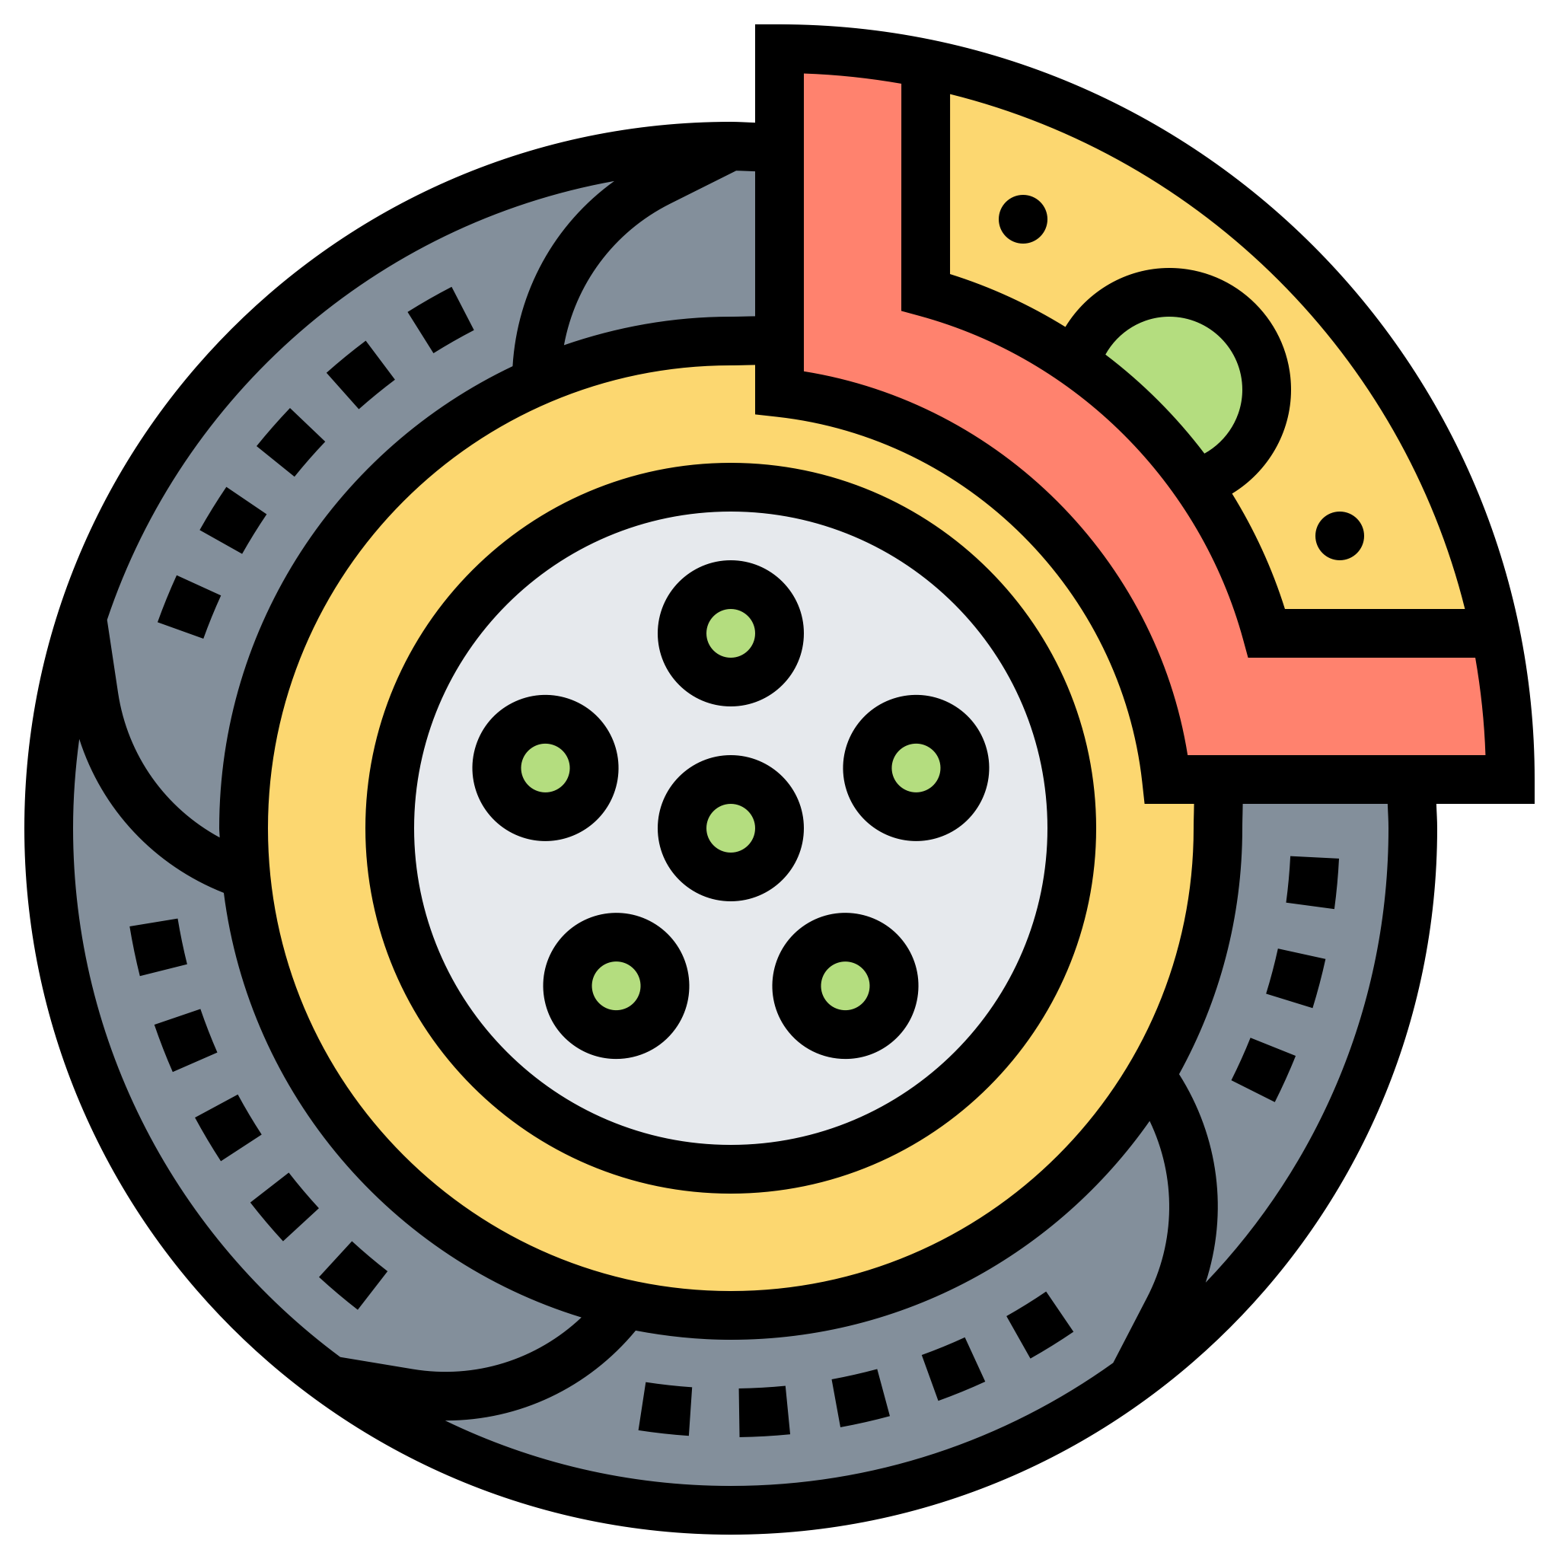


Componentization via Services
Componentization
Services
Libraries as components - in-memory function calls.
Out-of-process components - web service request or remote procedure call.
component
Componentization via Services
component
component
Component is a unit of software that is:
independently
replaceable
upgradeable
component
component
Product
component
component
component

Slide 5


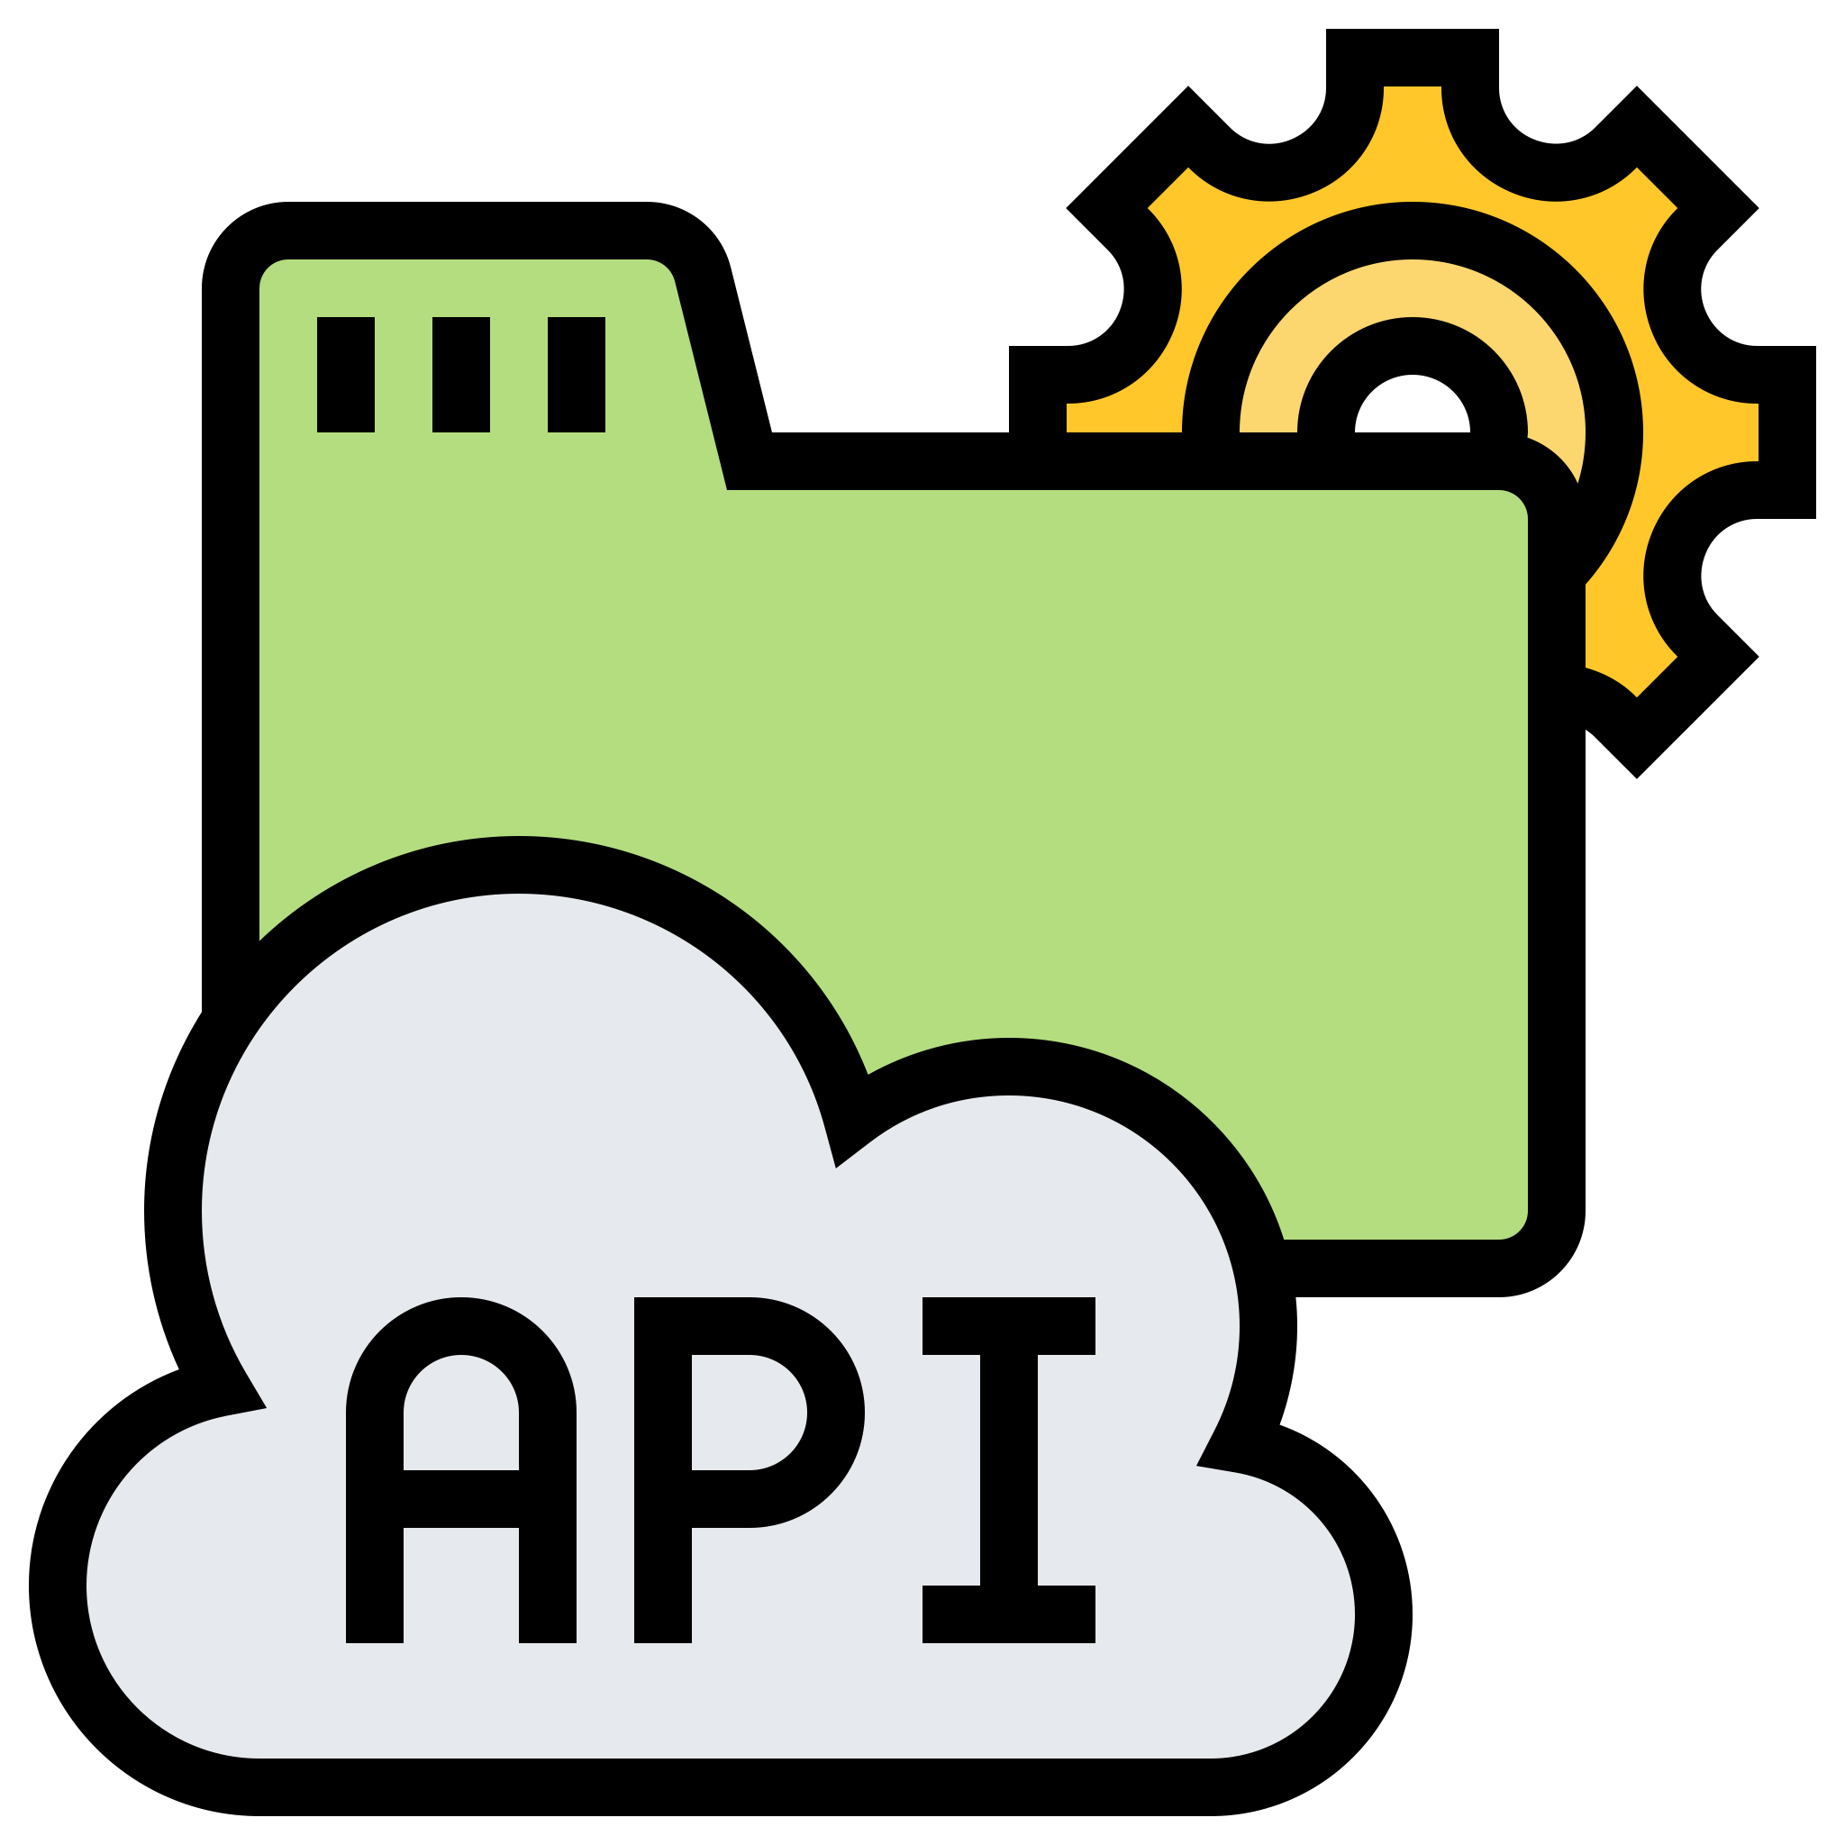

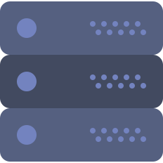



Organized around Business Capabilities
"
Any organization that designs a system (defined broadly) will produce a design whose structure is a copy of the organization's communication structure.
-- Melvyn Conway, 1967
UI
Specialist
"
Middleware
Specialist
Simple changes can lead to a cross-team project taking time and budgetary approval.
DBAs
Security
Team
Conway’s law in action

Slide 6




Organized around Business Capabilities
The microservice approach is different, services organized around business capability.
Services take a broad-stack implementation of software for that business area:
user-interface
persistant storage
any external collaborations
Teams are cross-functional, including the full range of skills required for the development:
user-experience
Database
project management.

Slide 7













Products not Projects
Projects
Project A
the aim is to deliver some piece of software which is then considered to be completed
On completion the software is handed over to a maintenance organization and the project team that built it is disbanded
Microservice tend to avoid this model !
Project B
Products
Amazon's notion "you build, you run it" - development team takes full responsibility for the software in production.
Brings developers into day-to-day contact with how their software behaves in production and increases contact with their users.
They have to take on at least some of the support burden.

Slide 8
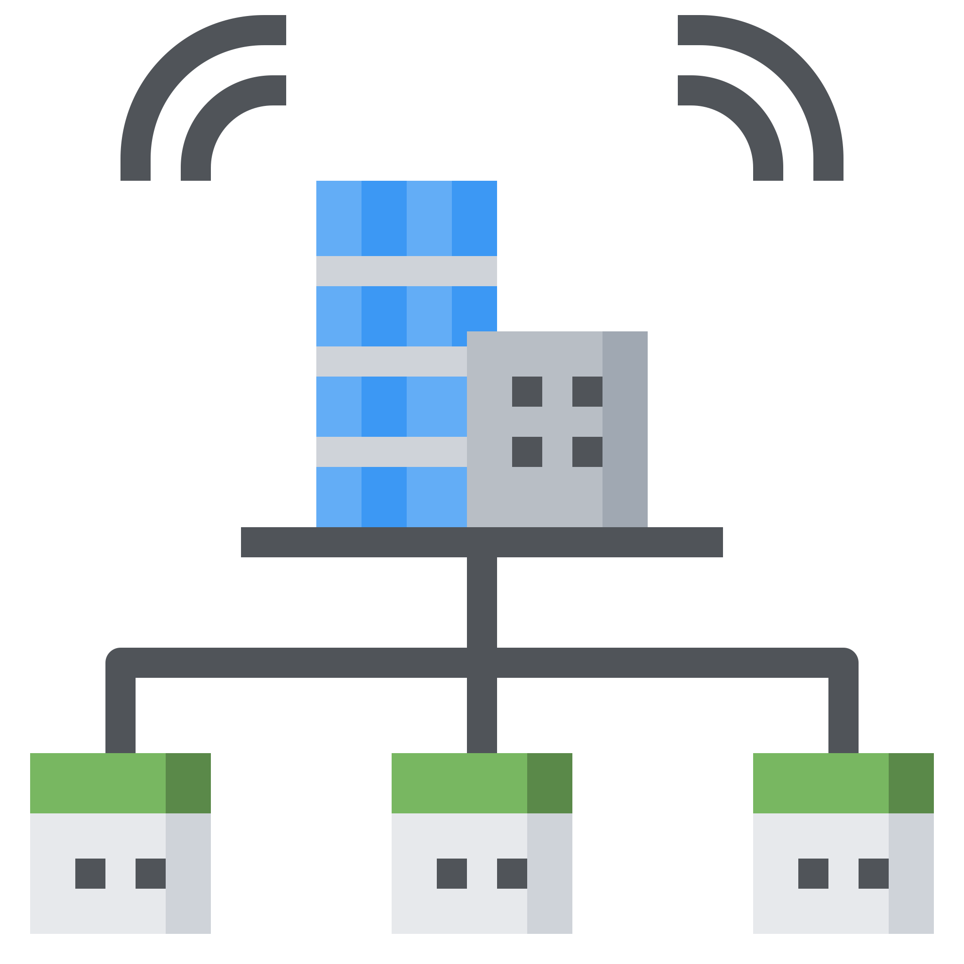
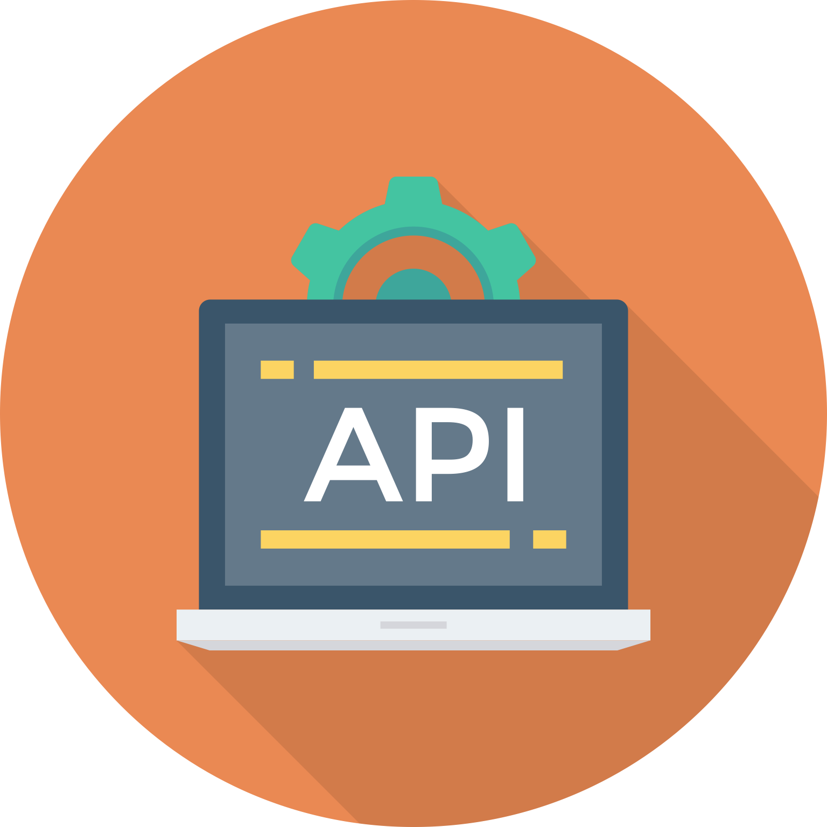

Smart endpoints and dumb pipes
Good example of "smart pipe"?
Enterprise Service Bus (ESB)
ESB products often include:
sophisticated facilities for message routing
choreography
transformation
business rules
Good example of "smart endpoints"?
Representational state transfer (REST)
http://api.example.com/device/managed?region=IT&sort=installation-date
Microservices aim to be as decoupled and as cohesive as possible:
own their own domain logic
receiving a request
applying logic and producing a response
Most used protocols are HTTP request-response and lightweight messaging.

Slide 9



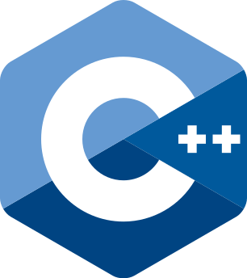






Decentralized Governance
Not every problem is a nail and not every solution a hammer!
By having the application splitted out into services we have a choice when building each of them. Of course, just because you can do something, doesn't mean you should.
The apogee of decentralised governance is the build it / run it principle popularised by Amazon.

Slide 10




Decentralized Data Management
First approach with updates (often monoliths):
updating multiple resources => transactions for consistency
This approach lead to:
Consistency – guarantee from transactions
More time server response
Businesses can handle a degree of inconsistency in order to respond quickly to demand, as long there is a process to deal with mistakes.
Users
Messages
GET user/{id}/friends GET user/{id}/ GET user/{id}/messages GET user/{id}/timeline
DB
Friends
DBs
The trade-off is worth it as long as the cost of fixing mistakes is less than the cost of lost business under greater consistency.
A useful way of thinking about this is the
Domain-Driven Design (DDD) notion of Bounded Context.
user/{id}/
Users
user/{id}/messages
Messages
user/{id}/timeline
user/{id}/friends
Friends

Slide 11






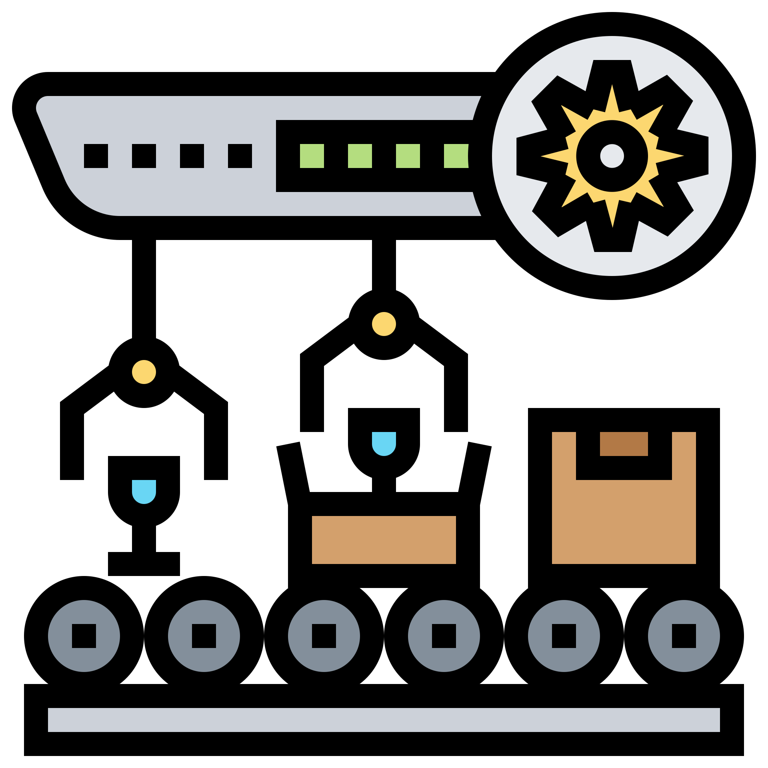







Infrastructure Automation
The aims of CD is to make deployment boring, as long as its still boring it doesn't matter.
How to achieve that ?
We want as much confidence as possible that our software is working
Test automation !
One of the best approach is the Test Driven Development (TDD).
Along a CI/CD tool this approach will boost your confidence with the delivered code.

Slide 12

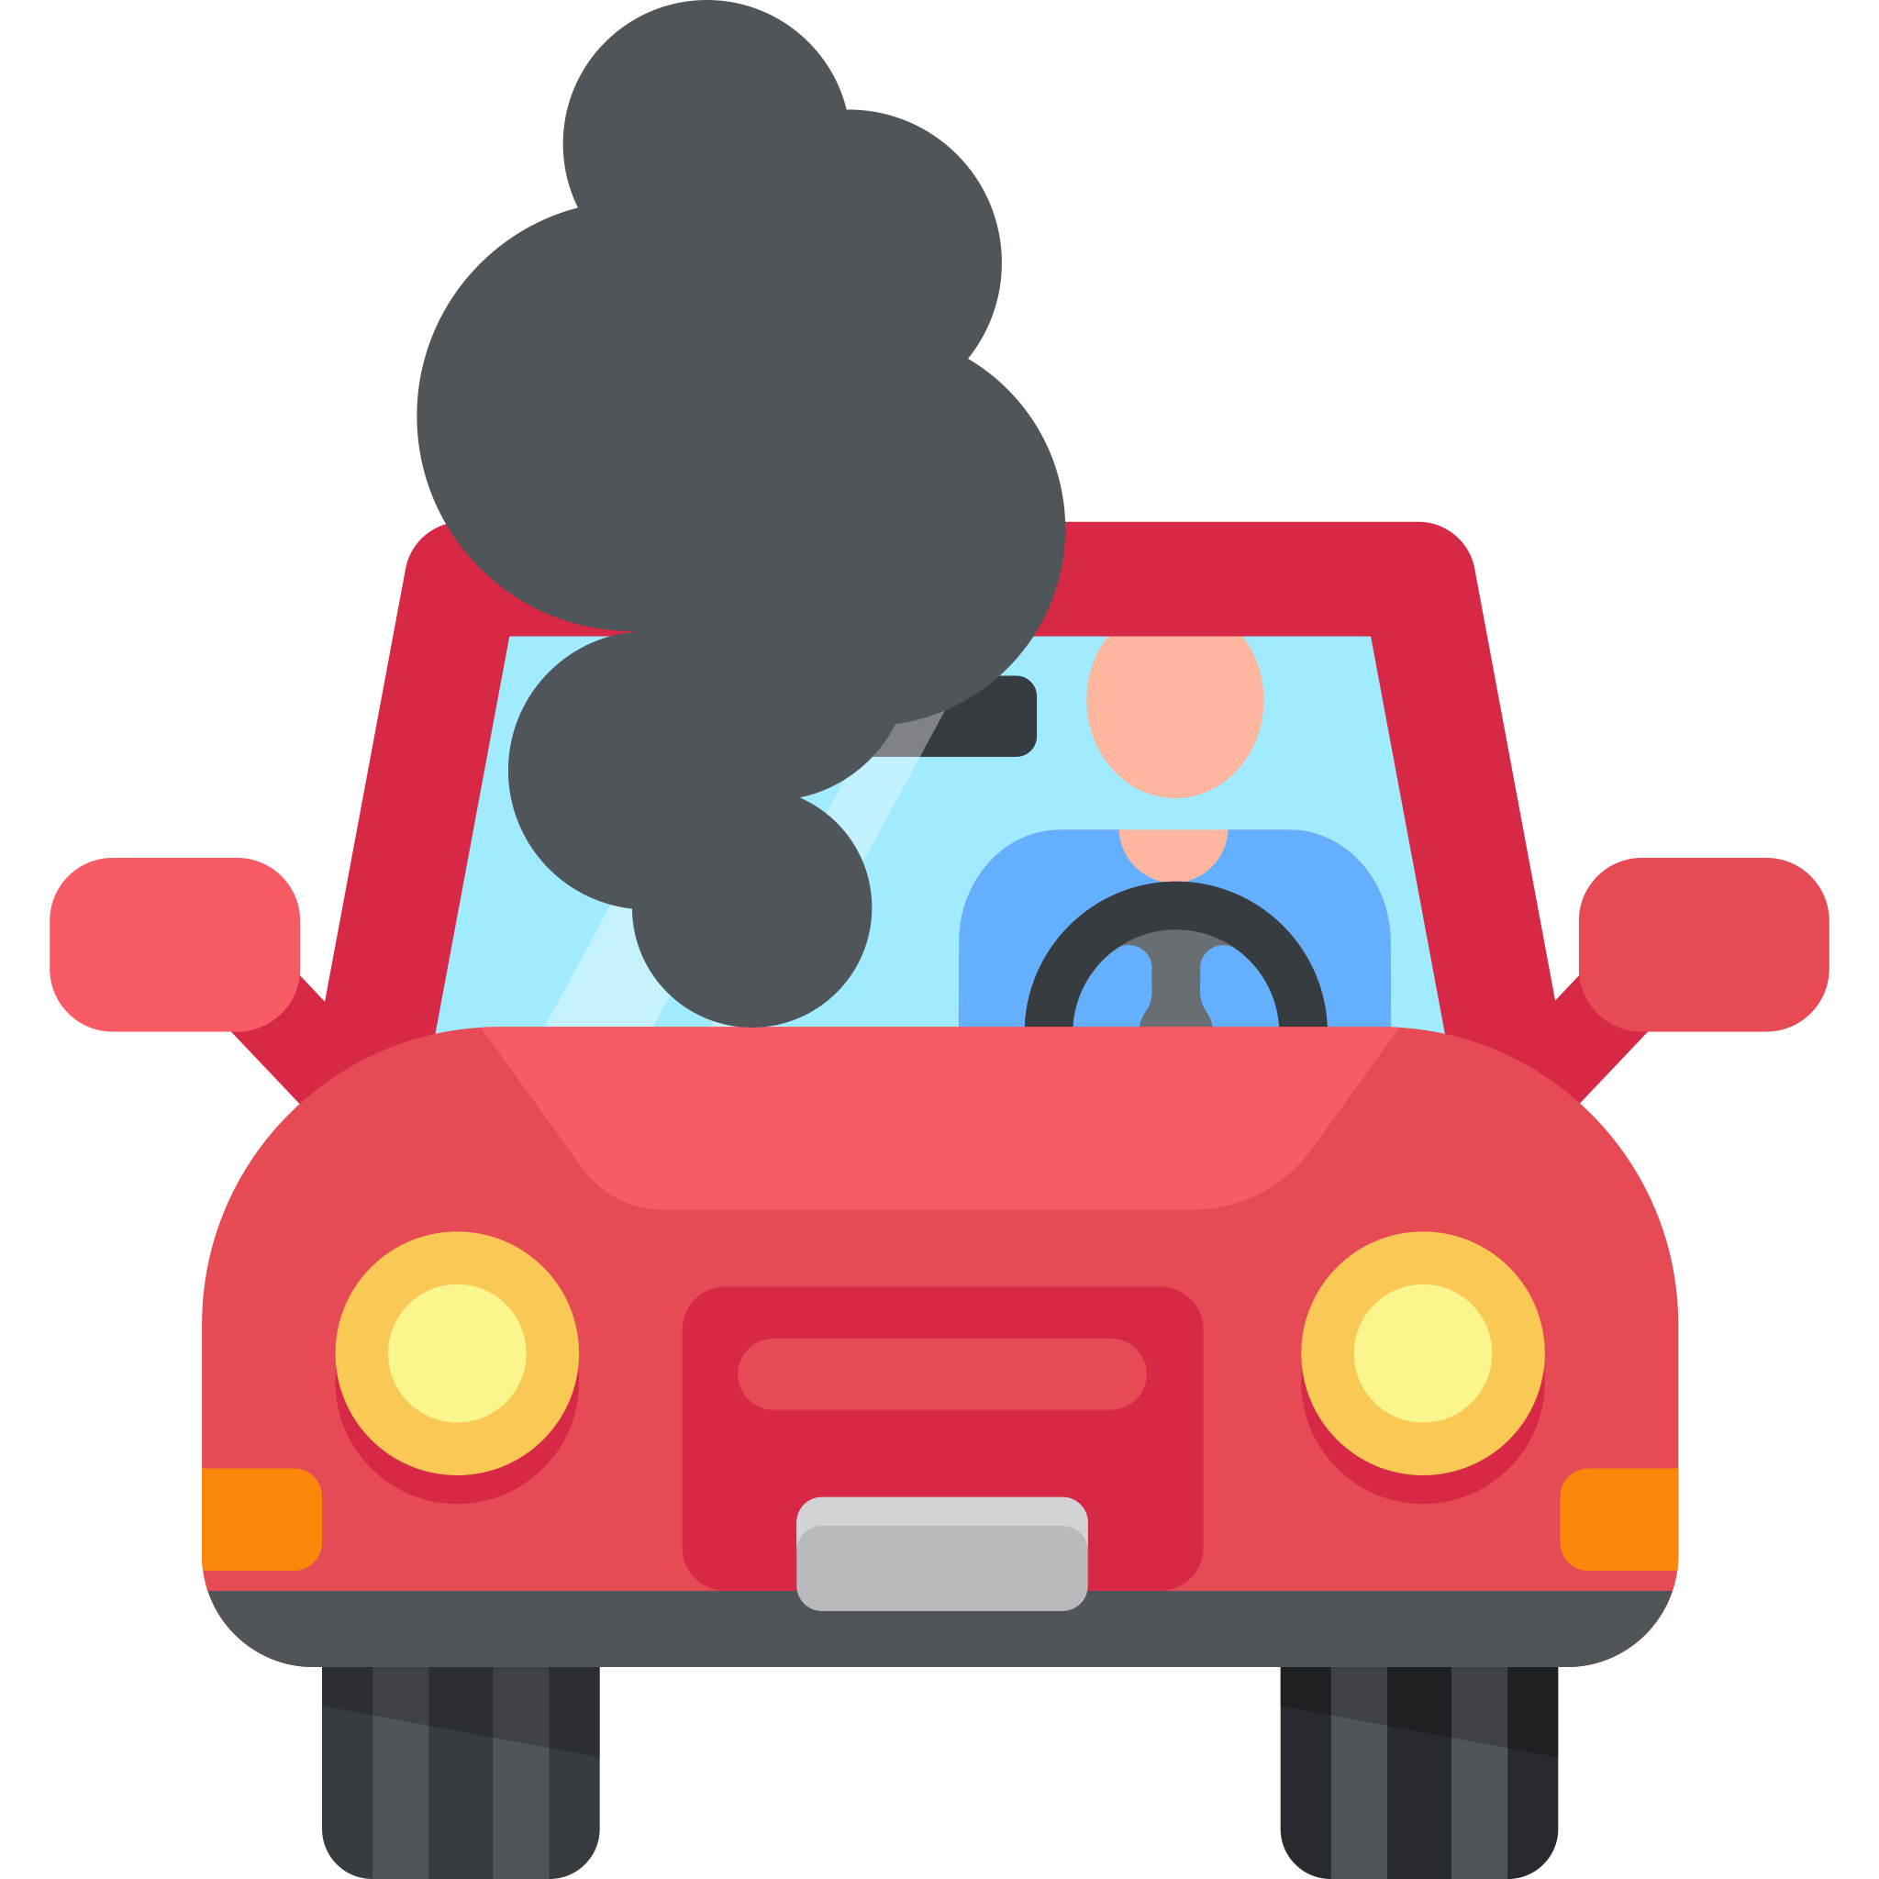



Design for failure
Having distributed services means that applications need to be designed so that they can tolerate the failure of services.
Increase application's resilience - circuit-breaker pattern.
When a service failure happened we can do one of the followings:
Custom fallback - Try from some other source. If not possible, use its own cache value
Heal automatic - Periodically check if serviceB is working again
Don’t crash - serviceA should not crash
Fail fast - It should return ASAP “knowing” that serviceB is down
All other APIs should continue to work.
Microservice teams expect to see monitoring and logging setups for each service:
dashboards showing up/down status
current throughput and latency
circuit breaker status
operational and business relevant metrics

Slide 13

Microservice Trade-Offs
Like any architectural style, microservices bring costs and benefits.
Strong Module Boundaries
Operational Complexity
Microservices reinforce modular structure, which is particularly important for larger teams.
You need a mature operations team to manage lots of services, which are being redeployed regularly.
Independent Deployment
Eventual Consistency
Simple services are easier to deploy, and since they are autonomous, are less likely to cause system failures when they go wrong.
Maintaining strong consistency is extremely difficult for a distributed system, which means everyone has to manage eventual consistency.
Technology Diversity
Distribution
With microservices you can mix multiple languages, development frameworks and data-storage technologies.
Distributed systems are harder to program, since remote calls can be slow and are always at risk of failure.
Don’t forget the more important issues that drive the success and failure of software projects.
Soft factors such:
quality of people on the team
how well they collaborate with each other
the degree of communication with domain experts
clean code
good testing
attention to evolutionary architecture

Slide 14

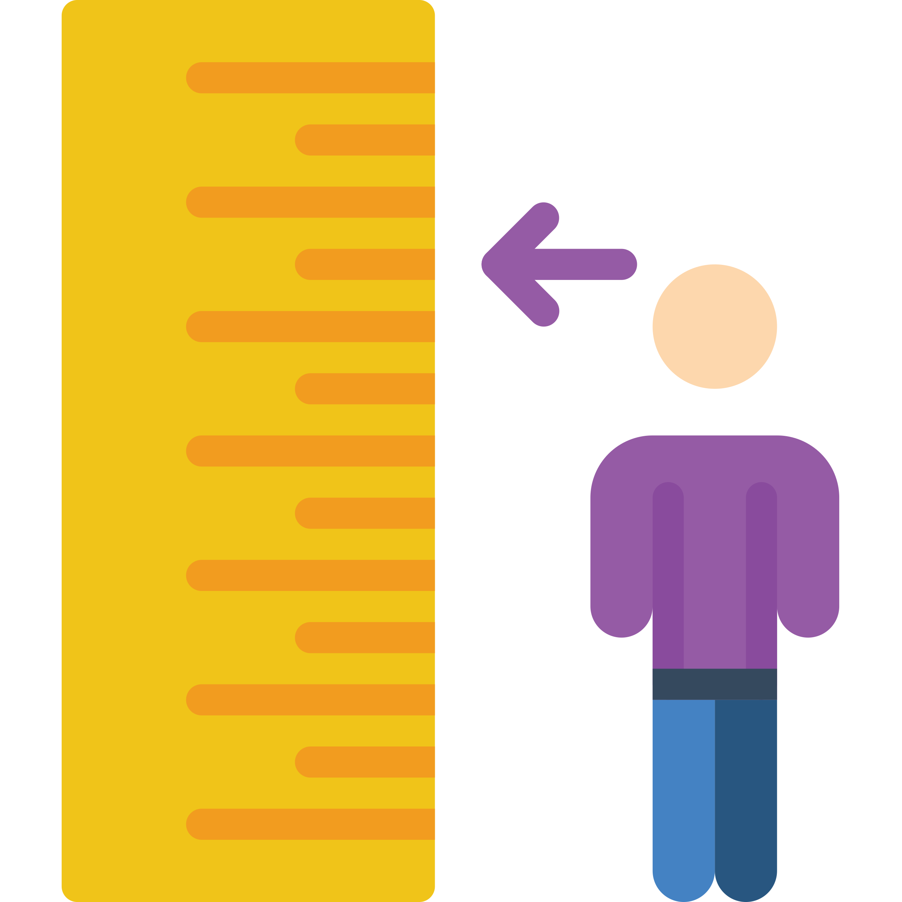
When and why use microservices
With any architectural decision there are trade-offs.
If you don't have certain baseline competencies, you shouldn't consider using the microservice style.
You must be this tall to use microservices
What do you need ?
Rapid provisioning You should be able to fire up a new server in a matter of hour. To be able to do such rapid provisioning, you'll need a lot of automation.
Basic Monitoring with services things can go wrong in ways that are difficult to detect in test environments. As a result it's essential that a monitoring regime is in place to detect serious problems quickly.
Rapid application deployment with many services to manage, you need to be able to quickly deploy them. This involve a DeploymentPipeline that can execute in no more than a couple of hours.

Slide 15
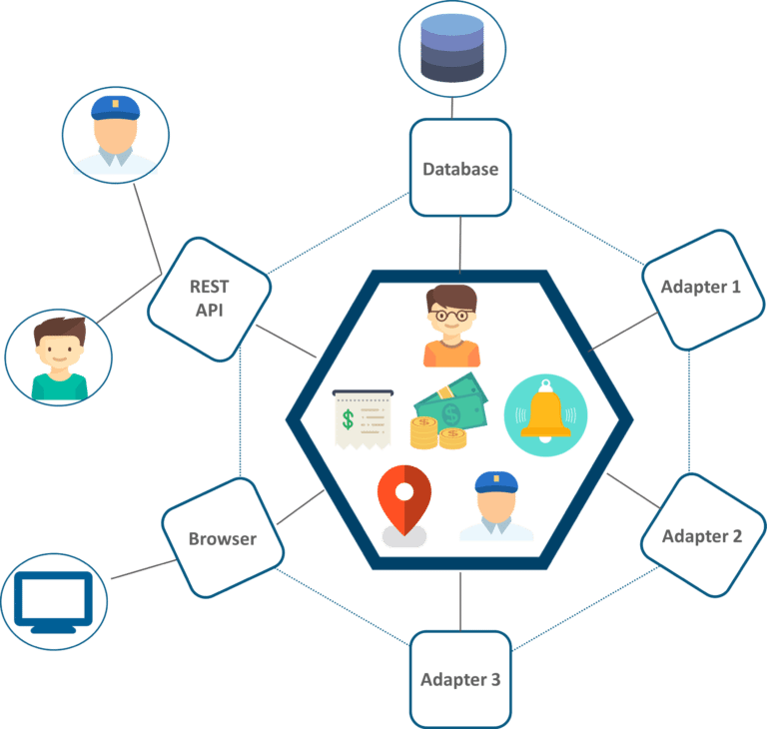
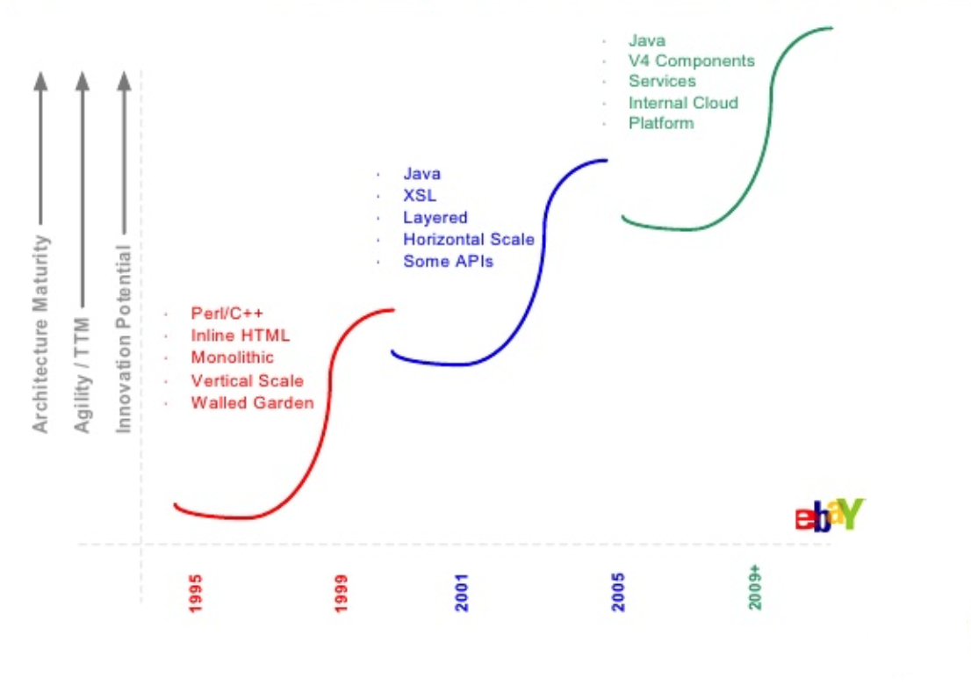
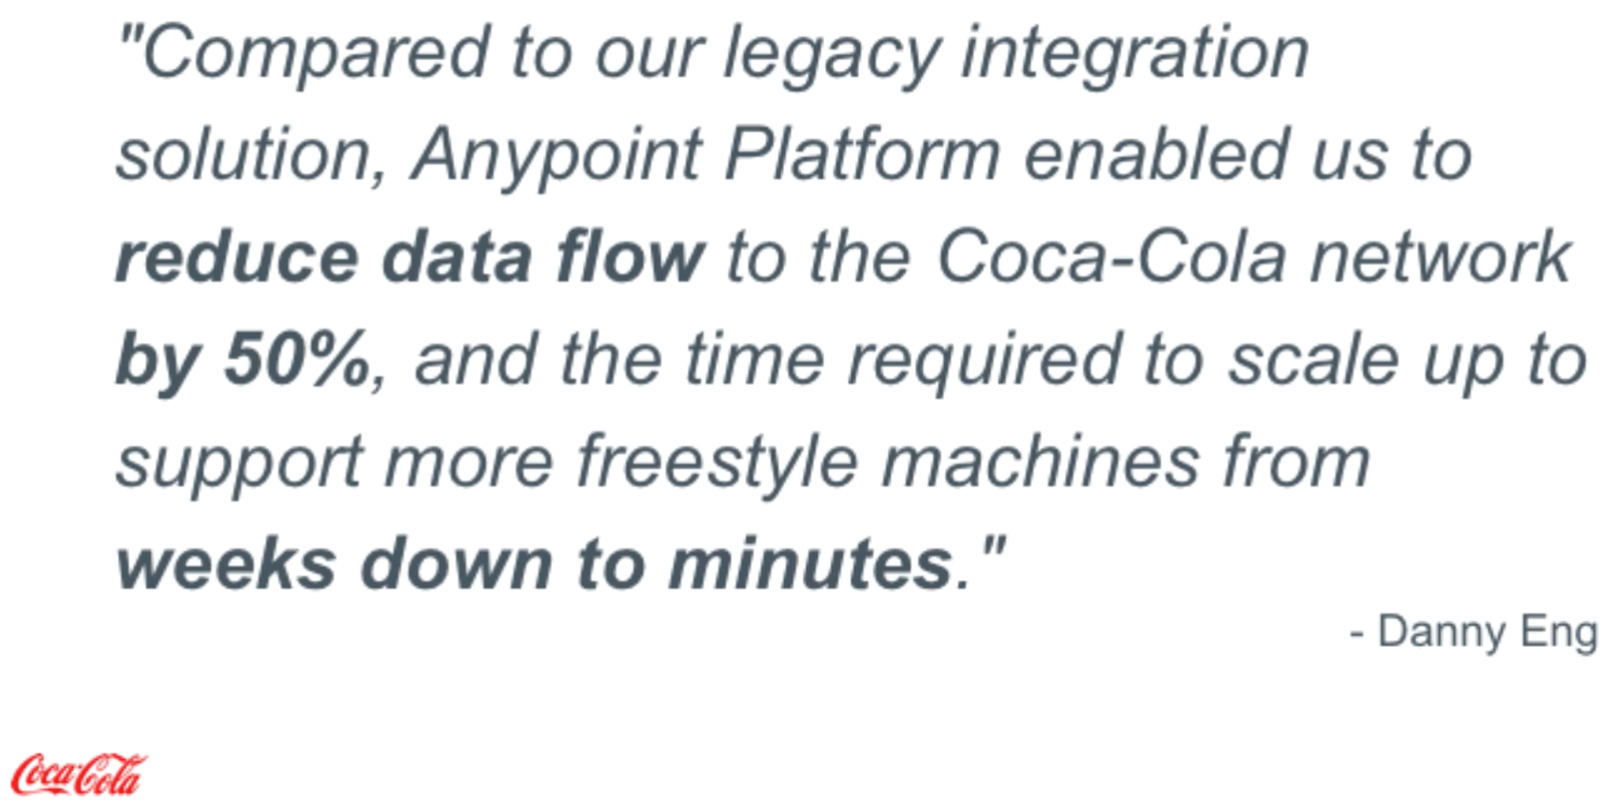
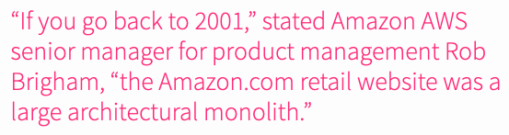






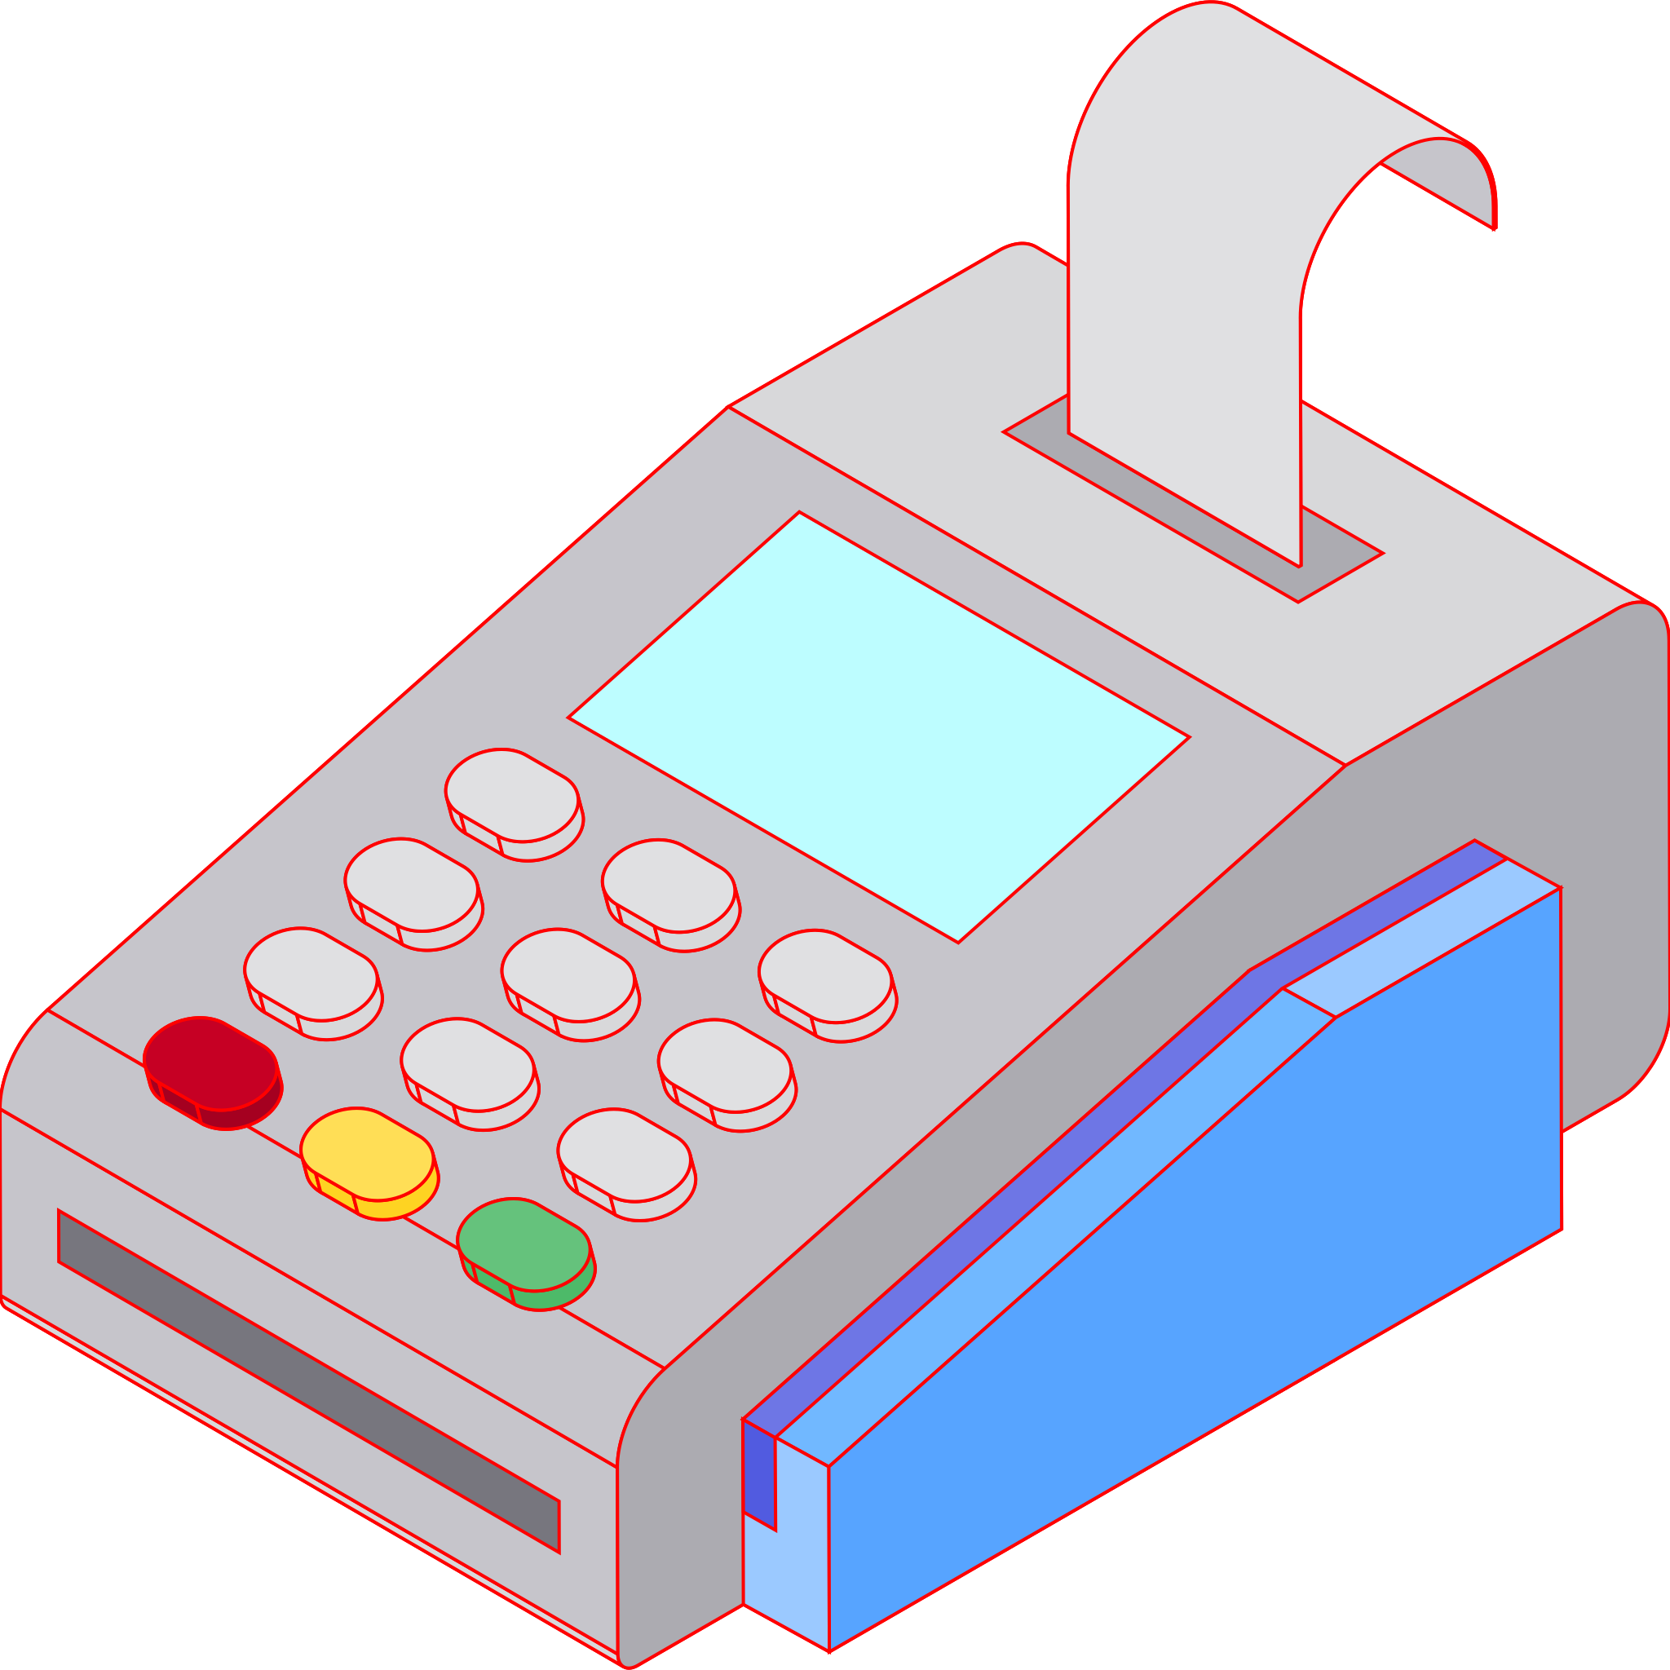
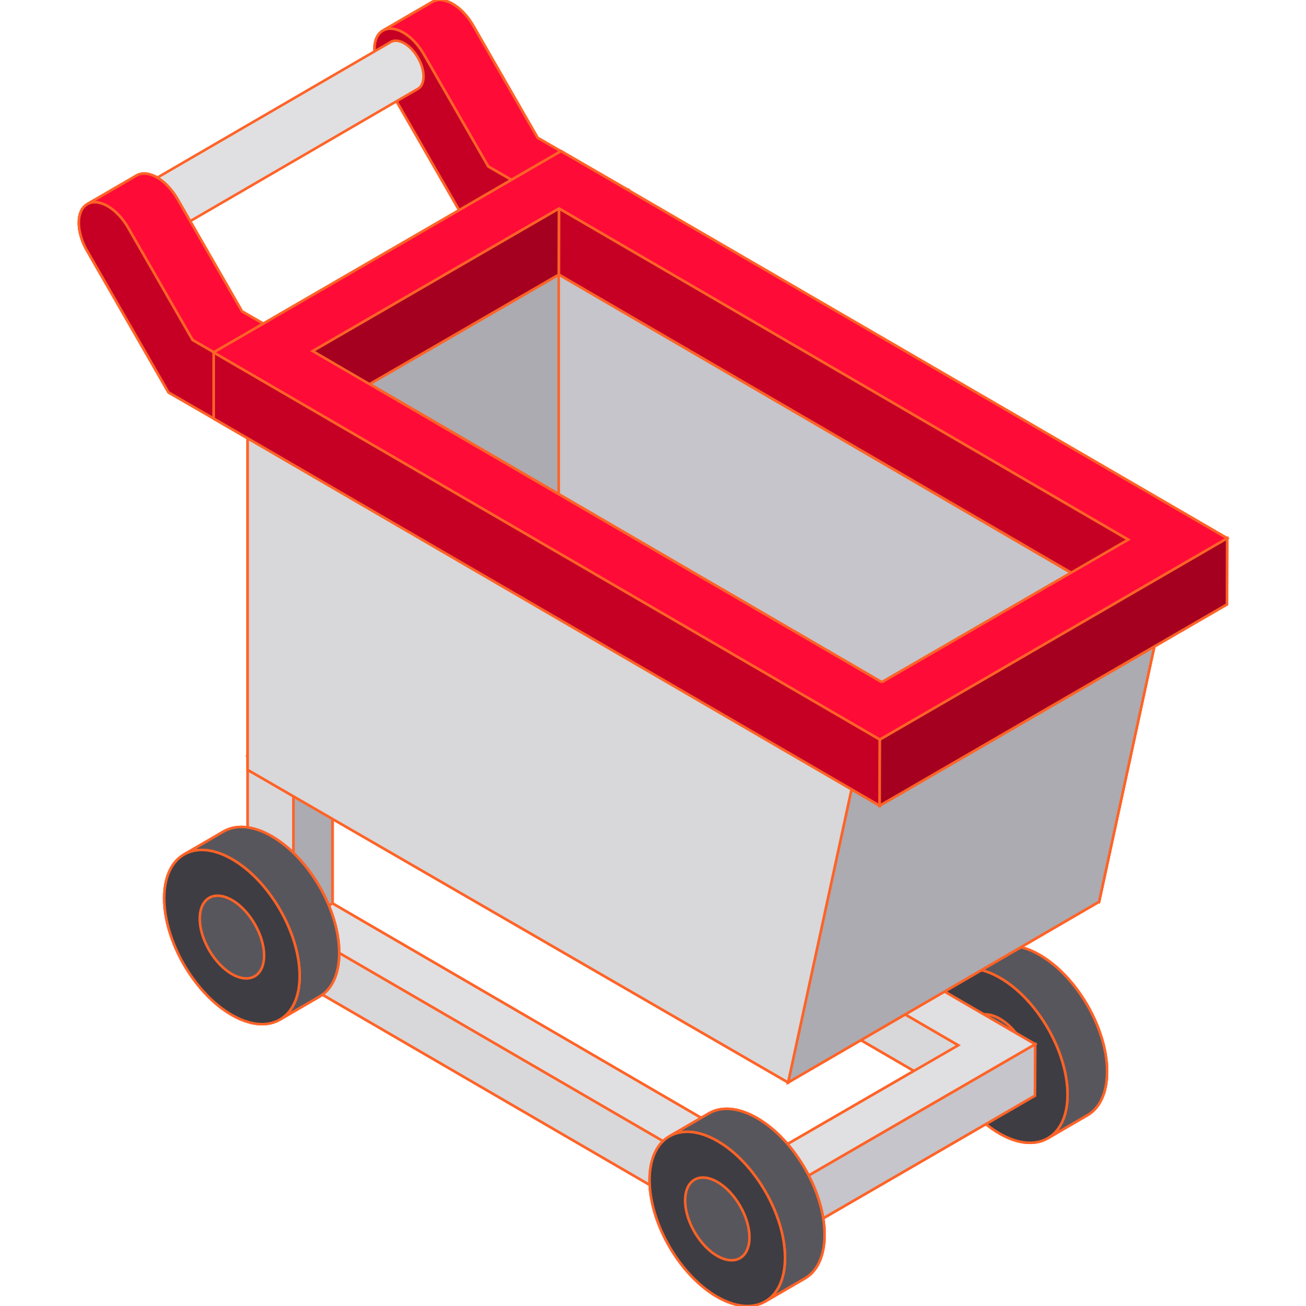


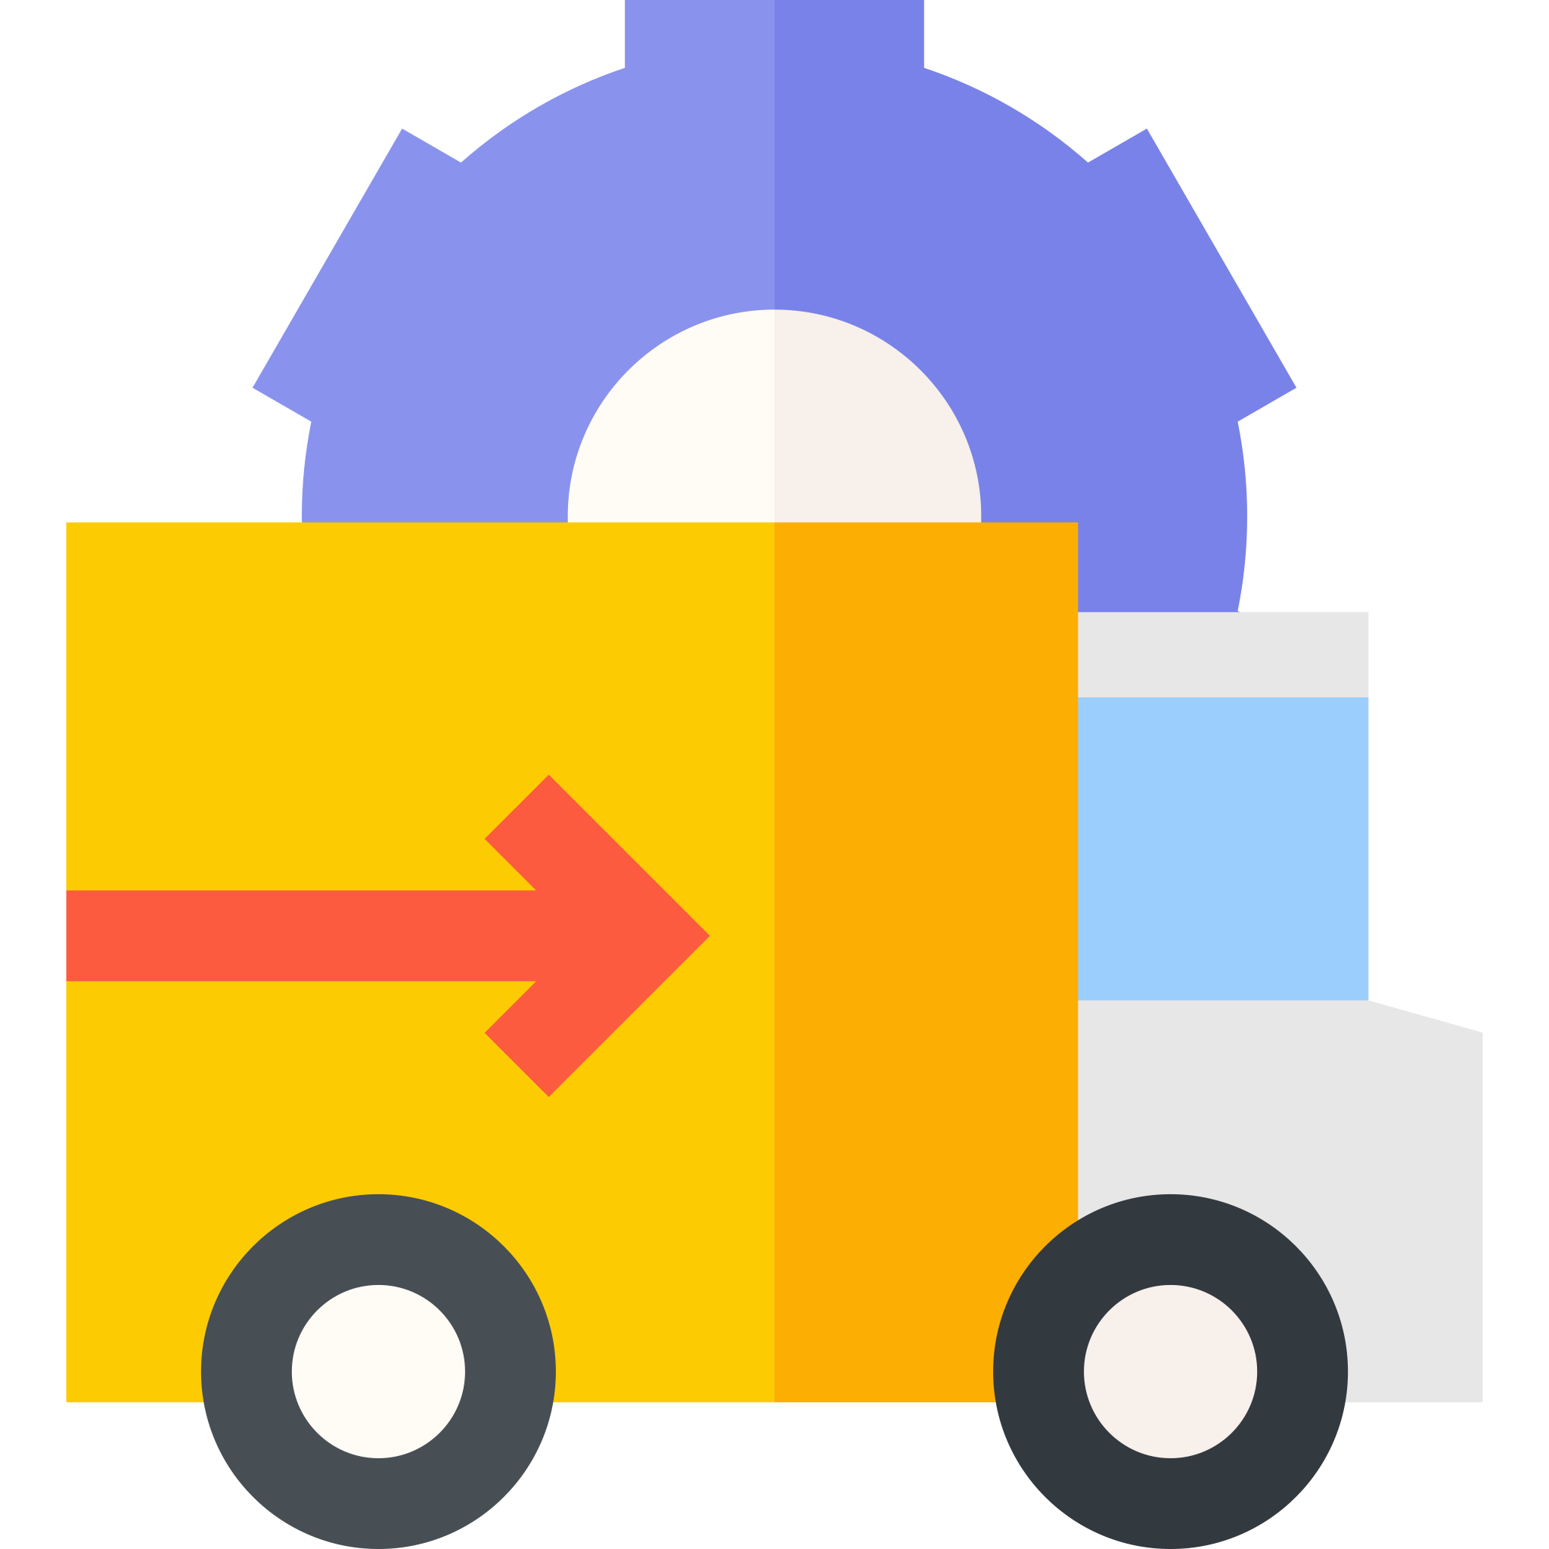



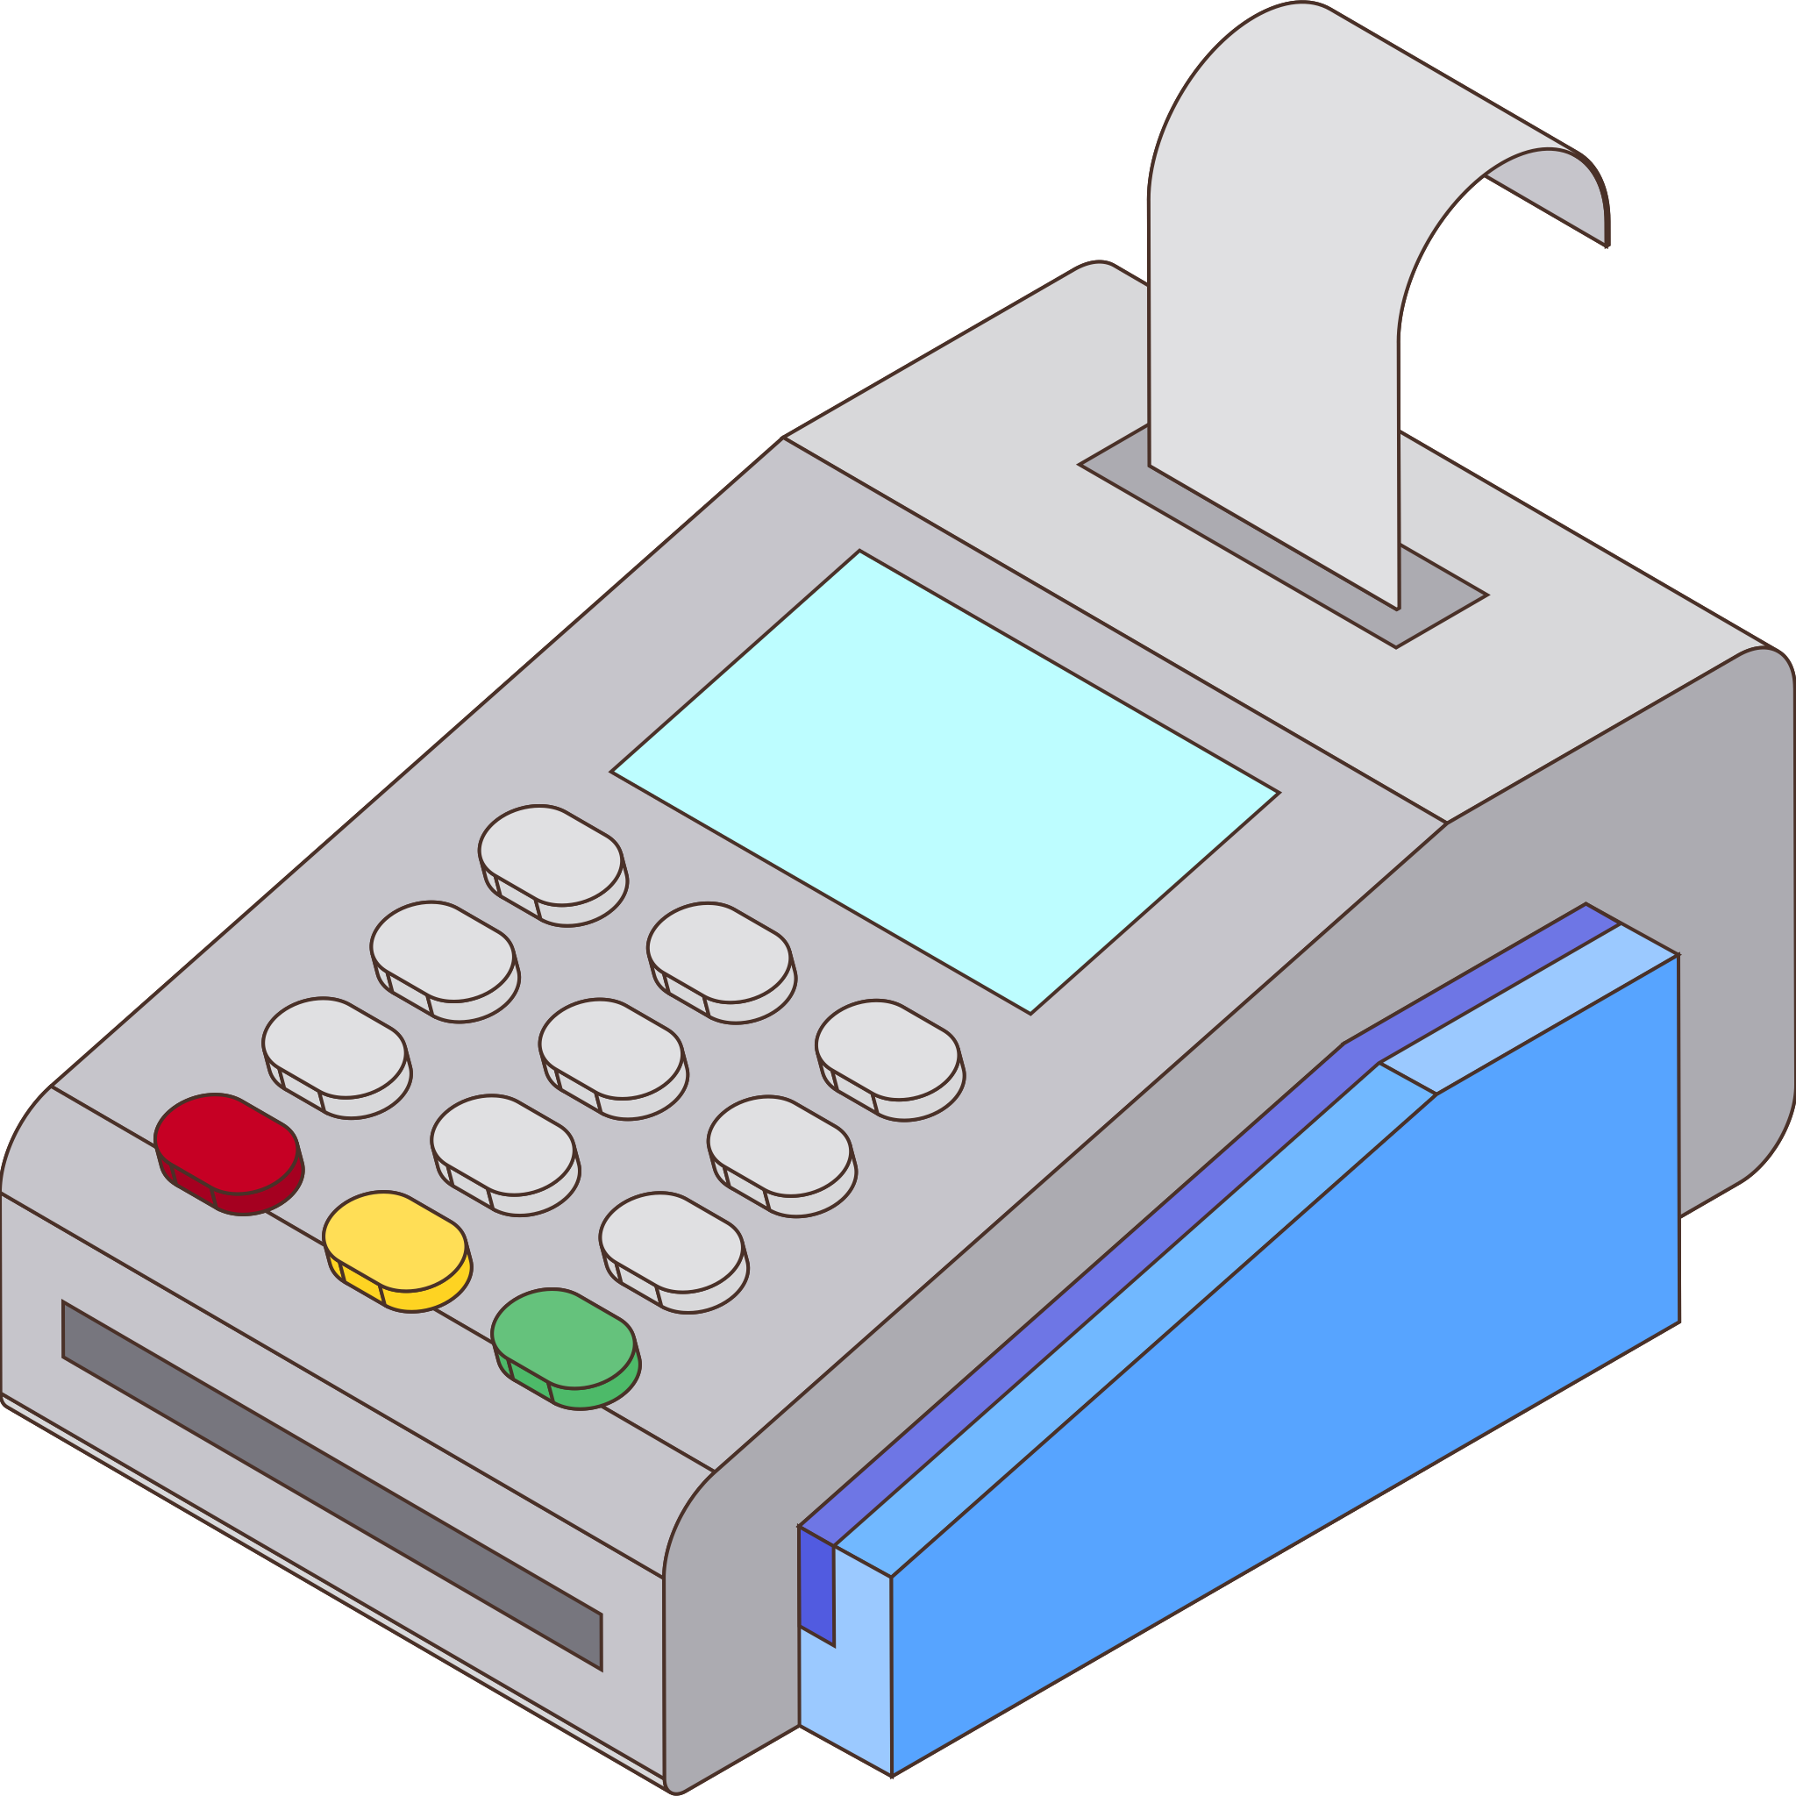
When and why use microservices
Almost all the successful microservice stories have started with a monolith that got too big and was broken up
It’s easy to find many cases that was built as a microservice system from scratch and has ended up in serious trouble.
You shouldn't start a new project with microservices, even if you're sure your application will be big enough to make it worthwhile.
This path can hide monsters…
For many people throwing away a code base is a sign of failure, but often the best code you can write now is code you'll discard in a couple of years time.

Slide 16
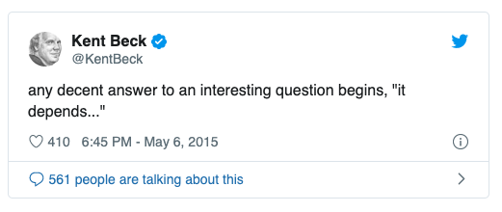
When and why use microservices
Is a microservice architecture a good choice for the system you're working on?
It depends …
Microservices Architecture feels like "premium" with deployment, monitoring, dealing with failure and so on …
Tips: don't even consider microservices unless you have a system that's too complex to manage as a monolith.
Tips: don't be afraid of building a monolith that you will discard, particularly if a monolith can get you to market quickly.
There are plenty of differents architecture, monoliths and microservices are not a simple binary choice. Remember that with the cloud environments popping out there are possibility for inifinite hybrid solutions that will fit your business.
To remember
Noticeable example: cookie-cutter deployment.

Slide 17

What is a microservice?
An example from a real world
At Netflix they have a complex configuration to describe a microservice:
Client Application
We tend to see them very simplistic, a simple service that will be calld, horizontally scalable
Client Library
EVCache Client
Servce Client
At some point you will need data, for whatever reason
A Netflix approach is to provide client library to clients for basic access operations
…
At some point you will need a cache layer when you scale up because data access is slow.
…
At this point you need some orchestration, you will hit the cache first. If it fails the call will hit the service to provide data from DB and fill the cache back for the next call.
…
Microservice
In the end the Client Library will be embedded in the client application that want to consume the service application
For Netflix this entire set of technologies and configuration is a Microservice.

Slide 18

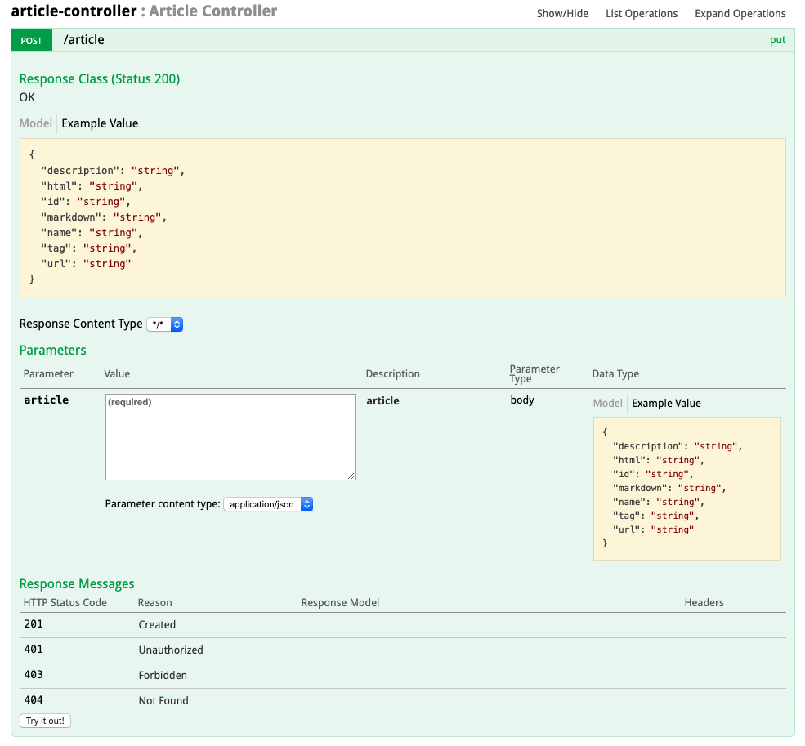
Java – Best Practices for microservices
API documentation
Your application will be called by other applications through REST-based API.
Clear documentation is required
The documentation should be generated along with the code
There are some tools for that. One of the most popular of them is Swagger
Swagger make your API usable by interact directly with the API through the Swagger UI. Why adopt Swagger in your project ?
Interactive Documentation
Save Time and Avoid Errors When Writing Code
You can choose the approach: Top-down/Bottom-up
The UI framework let developers and non-developers to interact with the API in a sandbox UI that gives clear insight into how the API responds to parameters and options. Let access the api to the business user can speed up the design process and reduce the risk of errors.

Slide 19

Java – Best Practices for microservices
Make your application transparent
Spring Boot Actuator brings production-ready features to our application.
Actuators is used to monitoring the app, gathering metrics, understanding traffic or the state of the database.
<dependency>
<groupId>de.codecentric</groupId>
<artifactId>spring-boot-admin-starter-server</artifactId>
</dependency>
It is desirable to monitor our instances in a single, central place.
This can be done by creating a dedicated Spring Boot application that includes Spring Boot Admin dependencies.
With this module you will ensure to have the fully monitoring and metrics of your applications like:
Memory usage
Variables
Logging level configurations
Logs (not a log aggregator)
It is also important knowing what's the current version, where it has been released and what changes it includes.
With maven it possible to expose the current commit through Actuators.
<plugin>
<groupId>pl.project13.maven</groupId>
<artifactId>git-commit-id-plugin</artifactId>
<configuration>
<failOnNoGitDirectory>false</failOnNoGitDirectory>
</configuration>
</plugin>

Slide 20

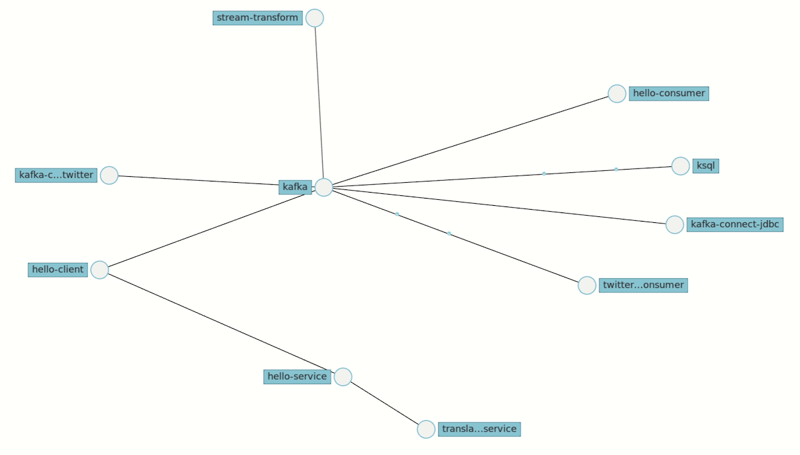
Java – Best Practices for microservices
HTTP and Tracing
In this park of microservices that aim to be decoupled and cohesive as much as possible, identifying where a problem has occurred start to be a complex problem.
Spring Cloud Sleuth implements a distributed tracing solution for Spring Cloud.
It will add custom headers to HTTP call, a spanID and TracingID, so the microservices can read it and forming a tree-like structure called a Trace.
Span - basic unit of work, started and stopped, identified by a unique 64-bit ID
Trace - another 64-bit ID shared by microservices to group all the Spans
You can capture data simply in logs, or by sending it to a remote collector service.
Zipkin helps gather timing data needed to troubleshoot latency problems in service architectures.
Features include both the collection and lookup of this data. If you have a trace ID in a log file, you can jump directly to it. That will reduce the time required for analysis a lot.

Slide 21

Java – Best Practices for microservices
Circuit Breaker
Circuit breaker is a design pattern used to detect failures and encapsulates the logic of preventing the failure of one service that can potentially cascade to other services throughout the application.
Base logic of the circuit breaker:
Closed – Allowing current to pass through (our services call will be done)
Half Open – Allowing current to pass through, if error occur will go in Open-state
Open - Not allowing current to pass through
The theory
Resilience4j library provides useful decorators to enhance any object with a Circuit Breaker, Rate Limiter, Retry or Bulkhead.
Useful example
Fallback for 2
cache
Circuit Breakers are part of the infrastructure between services and protect the system from both transient failures and buggy code.
1
2
3

Slide 22
Java – Best Practices for microservices
Cache services
At some point when you scale your application you will need to handle cache services, that’s because application with database may don't perform well enough. There are various approach:
[1]
Appl.
Embedded Cache - The simplest possible caching patter.
Cache
Embedded Distributed Cache – is the same pattern however, this time the cache is distributed and managed.
[3]
[2]
Appl.
Cache server
Cache
Client/Server - The application uses cache client to connect to Cache Server, if there is no value found, then perform the usual business logic, cache the value, and return the response
Cluster
manager
Cache
Appl.
Cache
Cache
Sidecar – Moving to container environments, near the application container will be deployed a cache container managed by a cluster manager.
[4]
Appl. container
Appl.
Appl.
Cache container
Cluster
manager
Reverse proxy - Load Balancer checks if the request is already cached. If yes, the response is sent back and the request is not forwarded to the Application.
Cache container
Appl.
Load Balancer
Appl. container
Cache
Appl.
You just need to choose which approach suits your application best.
[5]

Slide 23
Java – Best Practices for microservices
"
Everything should be built from the top down, except the first time.
- Alan Perlis
Spring/Java best practices
"
Design microservices API, Top down or bottom up?
In principle, the first option is always better. When you
starting a project write something that works to help refine
ideas about what it is that you are trying to build. After you have a better understanding of what your service needs to do, go back and refine the domain model and define the external APIs to match.
Applying domain-driven design principles
domain is a particular area of knowledge or activity. A model is an abstraction of important aspects of the domain that emerges over time. This model is then used to build the solution, for cross-team communications.
Bounded contexts allow a domain to be subdivided into independent subsystems. Each bounded context can then have its own models for domain concepts.
Context mapping, including the development and use of ubiquitous language, can help ensure that disparate teams working on individual services understand how the big picture should fit together.

Slide 24
Java – Best Practices for microservices
Spring/Java best practices
Use the correct HTTP verb
GET operations must be both idempotent and nullipotent. They should cause no side effects, and should only be used to Retrieve information.
POST operations may be used to Create resources. The distinguishing characteristic of a POST operation is that it is not idempotent.
PUT operations can be used to Update resources. PUT operations usually include a complete copy of the resource to be updated, making the operation idempotent.
PATCH operations allow partial Update of resources. They might or might not be idempotent depending on how the delta is specified and then applied to the resource.
DELETE operations are not surprisingly used to Delete resources. Delete operations are idempotent, as a resource can only be deleted once. However, the return code varies, as the first operation succeeds (200), while subsequent invocations do not find the resource (204).

Slide 25
Java – Best Practices for microservices
Spring/Java best practices
API versioning
One of the major benefits of microservices is the ability to allow services to evolve independently but that independence comes with a giant warning.
You cannot cause breaking changes in your API.
If you do need to make breaking API changes for an existing service, you need to decide:
Will the service handle all versions of the API?
Will you maintain independent versions of the service to support each version of the API?
Will your service support only the newest version of the API and rely on other adaptive layers to convert to and from the older API?
After you decide on the hard part, the much easier problem to solve is how to reflect the version in your API. There are generally three ways to handled versioning a REST resource:
Put the version in the URI
Use a custom request header
Put the version in the HTTP Accept header and rely on content negotiation

Slide 26
Java – Best Practices for microservices
Spring/Java best practices
Package by feature, not layer
Package-by-feature uses packages to reflect the feature set. It tries to place all items related to a single feature into a single directory/package. This results in packages with high cohesion and high modularity, and with minimal coupling between packages.
Manage transactions properly
The place to demarcate transactions in a Spring enabled application is service layer, nowhere else. You should only mark @Service beans as @Transactional or their public methods.
Plus as general advice, avoid use @Transactional in method that use only select operations.
If you need for session context reason, use @Transactional(readOnly=true) to avoid dirty checking and have a good performance.
Annotation-Based Validation
There is no need to do manual tests. Try to adopt javax.validation library to check input so Spring will intercept the request and validate it before the method is invoked.
Examples :
@Size(min=2, max=30)
@NotNull

Slide 27

Java – Microservices infrastructure
Spring Cloud - Netflix OSS
In Spring Cloud one of the possible implementation for the infrastucture and the most famus is the Netflix OSS.
What is Netflix OSS ?
Netflix OSS is a set of frameworks and libraries that Netflix wrote to solve some interesting distributed-systems problems at scale.
Today, for Java developers, it’s synonymous with developing microservices in a cloud environment. Patterns for service discovery, load balancing, fault-tolerance, etc are incredibly important concepts for scalable distributed systems and Netflix brings nice solutions for these.
In Netflix OSS based stack Eureka is considered the hub using which the microservices register themselves and discover each other.

Slide 28
Java – Microservices infrastructure
Spring Cloud – Configuration server
Spring Cloud Config provides server-side and client-side support for externalized configuration in a distributed system. With the Config Server, we have a central place to manage external properties for applications across all environments.
Why use a Config Server?
With an embedded configuration file and/or hard coded information in the project code, if there are any changes in the configuration, you need to compile, repack the project and re-deploy it. This is obviously a challenge in a distributed application environment.
The idea to solve the above problem is that a service (application) running independently is required to manage configurations for other services.
Runtime configuration refresh
When you change a configuration file on the Config-Server, you will surely want to notify of such changes to Clients. The Spring Cloud Bus provides a mechanism for informing to Clients that "There is a change" and requires the Clients to update new information.

Slide 29
Java – Microservices infrastructure
Spring Cloud - Netflix OSS
A simple architecture that will be our example:
Pong
Load props
Register
Config
Discovery
Call
Load props
Eureka
Register
There are 2 microservices here:
A pong service which responds to "ping" messages
A ping service which uses the "pong" micro-service
And there are two infrastructure components:
Config which provides a centralized configuration for the 2 microservices
Eureka which is the central hub providing a way for the services to register themselves and discover other services
Ping
Load props

Slide 30
Java – Microservices infrastructure
Load balancing - Eureka server
What is Eureka?
Eureka is a REST based service used for locating services for the purpose of load balancing and failover of middle-tier servers.
The client provided to consume Eureka service also has a built-in load balancer that does basic round-robin load balancing.
What is the need for Eureka?
In a distributed and dynamic environment we can’t use the traditional load balancers that works with servers with well known IP addresses and host names.
Load balancing requires much more sophistication in registering and de-registering servers with load balancer on the fly.
How it works?
Services register with Eureka and then send heartbeats to renew their leases every 30 seconds. If the client cannot renew the lease for a few times, it is taken out of the server registry in about 90 seconds. The clients can look up the registry information (happens every 30 seconds) to locate their services and make remote calls.

Slide 31
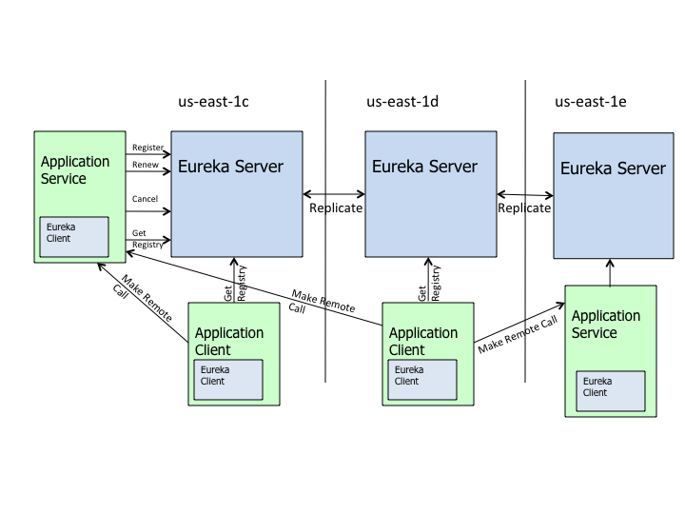
Java – Microservices infrastructure
Load balancing - Eureka server
Eureka high level architecture
This architecture depicts how Eureka is deployed and how you would typically run it. There is one eureka cluster per region which knows only about instances in its region. There is at the least one eureka server per zone to handle zone failures.
The communication technology could be anything
we like for example we can use Eureka to obtain the
target server address and use protocols such as thrift, http(s) or any other RPC mechanisms.
For services that are non-Java based, we have a choice of implementing the client part of eureka in the language of the service or we can run a "side car" which is essentially a Java application with an embedded eureka client that handles the registrations and heartbeats.

Slide 32

Java – Microservices infrastructure
Monitoring
How to
Application performance monitoring (APM) is a market unto itself and how to monitoring the microservices higtly depends on how the infrastructure is builded up.
Here we have choose to show the implementation of Netflix OSS and with this choice it can be done for example with Spring Boot Admin, by fetch the exposed actuactor endpoints. Another choice culd be using Hystrix, by using the histrix endpoint.
If we choose to use Spring but deploy the infrastracture with a series of containers orchestrated by kubernates probably we will use K8s API to monitor our application.
There are planty of APM software, open-source or not, all of them offer functionality to cover all requirements of monitoring an application.
It’s a matter only to choose the one that suit the most your needs.

Slide 33
Java – Microservices infrastructure
How to break a Monolith into Microservices
Starting point
It is necessary for developers and architects to closely evaluate whether the decomposition of an existing monolith is the right path, and whether the microservices itself is the right destination.
Prerequisites
Migrating a monolithic system is an hard journey, and the ones who embark on this journey needs to meet some precise conditions:
They want to grow their number of teams while enabling them to deliver value in parallel and independently of each other.
They want to rapidly experiment with their business's core capabilities and deliver value faster.
They also want to escape the high cost associated with making changes to their existing monolithic systems.
There are many techniques to accomplish this task, in this slides we will explain one of them.

Slide 34





Java – Microservices infrastructure
How to break a Monolith into Microservices
To make this explanation we will use a multitier online retail application as our target application to be migrated into microservices architecture.
Start by get all the tools
A suggestion is to build out the underlying infrastructure, continuous delivery pipelines and the API management with the first service that will be decompose or builded new.
First I recommended decoupling simple edge services. Next we take a different approach decoupling capabilities deeply embedded in the monolithic system.
Why ?
At the beginning of the journey, the delivery teams' biggest risk is failing to operate the microservices properly. It’s good to use the edge services to practice the operational prerequisites they need.

Slide 35
Java – Microservices infrastructure
How to break a Monolith into Microservices
Minimize Dependency Back to the Monolith
Having dependencies to the monolith - data, logic, APIs - couples the service to the monolith's release cycle, prohibiting the major benefit of microservices to have a fast and independent release cycle.
Teams may not be always able to avoid dependencies back to the monolith. In this cases is suggested to expose a new API from the monolith, and access the API in a new service to make sure that the monolith concepts do not leak out.
In this unfortunate case the delivery teams will be bearing the cost and difficulty of changing the monolith, testing and releasing the new services coupled with the monolith release.
Preferred dependency direction

Slide 36
Java – Microservices infrastructure
User Session
How to break a Monolith into Microservices
Split Sticky Capabilities Early
At this point we assume that the delivery teams are comfortable with building microservices and ready to attack the sticky problems.
In a monolith application that have capability not well defined as a domain concept, teams may find themselves limited to decouple next service without a dependency back to the monolith.
In order to be able to progress, the developers need to identify the sticky capability, deconstruct it into well defined domain concepts and then reify those domain concepts into separate services.

Slide 37
Java – Microservices infrastructure
How to break a Monolith into Microservices
Decouple Vertically and Release the Data
Simply:
keeping all the data in the same data store is counter to the Decentralized Data Management characteristic of microservices.
decoupled services needs to be able to release them independently.
This should be principles guide every decision that developers make around how to perform the decoupling.
The strategy is to move out capabilities vertically, decouple the core capability with its data and redirect all front-end applications to the new APIs.

Slide 38
Java – Microservices infrastructure
How to break a Monolith into Microservices
Decouple What is Important to the Business and Changes Frequently
For decoupling capabilities from the monolith many use the analogy of a careful organ surgery. Because this is a non-trivial amount of work, the developers need to continuously evaluate the cost of decoupling against the benefits that they get.
One type of analysis that can be done is:
looking for the code commit history to find out what has historically changed most
overlay that with the product roadmap and portfolio
Dev team
With this two you will understand the most desired capabilities that will be getting attention in near future, then:
talk to the business and product managers
Business
With this type of analysis you will find the module of the application that really matter for the business and that will take your attention in the future.
customer personalization service

Slide 39
Java – Microservices infrastructure
How to break a Monolith into Microservices
Decouple Capability and not Code
When you want to extract a service, you have basically 2 ways to do:
Extract code
Rewrite capability
Often monolith decomposition is imagined as a case of reusing the existing implementation as-is and extracting it into a separate service. The labor of building, no matter how painful the process or imperfect the result, make us grow love for it.
This is in fact known as the IKEA Effect.
It causes technical managers to disregard the high cost and low value of extracting and reusing the code.
Alternatively rewriting the capability gives the opportunity to:
Revisit the business capability
Simplify the legacy process
Technology refresh (if it the case)

Slide 40

Java – Microservices infrastructure
How to break a Monolith into Microservices
For our example, ‘pricing and promotion’ capability is an intellectually complex piece of code, rich of features like:
Dynamic configuration
Application of pricing and promotion rules
Discounts and offers based on a variety of parameters
This capability is arguably a good candidate for reuse and extraction. ‘Basket’ instead a simple CRUD capability that it is a good candidate for rewrite and maybe enhance.
In the majority of the decomposition scenarios is better off to rewrite the capability as a new service and retire the old code. This due to reasons such as:
Large amount of boilerplate code that deals with environmental dependencies
It is very likely that the existing capabilities are not built around clear domain concepts.
A long lived legacy code that has gone through many iterations of change could have a high code toxicity level and low value for reuse.
Extract
Retire
Reuse
Rewrite

Slide 41
Java – Microservices infrastructure
How to break a Monolith into Microservices - Conclusion
To reach our goal of break a monolith application into microservices, we need to keep in mind at every changes the hint explaned before and embrace the evolutionary architecture approach.
Every step of migration should generate a closer value to the architecture’s goal
Make steps as small as possible
Each step needs to be atomic, either completes or reverts
Remember to follow this pattern:
decouple the new service
Redirect all consumers to new service
Retire the old code path in the monolith
The anti-pattern: Decouple the new service, use for new consumers and never retire the old.
Migrating with this approach we can break up the journey to shorter trips. We can safely stop, revive and survive this long journey, slaying the monolith.

Slide 42

Java – Microservices infrastructure
Useful tools - Docker
What is docker ?
Docker is a tool designed to make it easier to create, deploy, and run applications by using containers. Containers allow a developer to package up an application with all of the parts it needs, such as libraries and other dependencies, and deploy it as one package.
Who is Docker for?
For developers - they can focus on writing code without worrying about the system that it will ultimately be running on.
For operations - Docker gives flexibility and potentially reduces the number of systems needed because of its small footprint and lower overhead.
Understanding containers
Containers necessitating three categories of software:
Builder: build a container.
Engine: run a container.
Orchestration: manage many containers.

Slide 43
Java – Microservices infrastructure
Useful tools - Docker
Key benefits of using Docker
Multi-Cloud Platforms – Portability All major cloud computing providers have embraced Docker’s availability and added individual support. Plus it can be run on every VM running Linux or Windows server. This grants you a level of abstraction from your infrastructure layer.
Environment Standardization and Version Control The environment for your application is defined by the Dockerfile that describe your container needs at build time, standardizing your environment. On top of that, Docker containers work just like GIT repositories with the container registry. It is very easy to rollback to a previous version of your Docker image.
Isolation Docker ensures your applications and resources are isolated and segregated.You can have various containers for separate applications running completely different stacks. Docker also ensures that each application only uses resources (CPU, memory and disk space) that have been assigned to them.

Slide 44




Java – Microservices infrastructure
Useful tools – CI/CD
Continuous integration (CI) and continuous delivery (CD) embody a culture, set of operating principles, and collection of practices that enable application development teams to deliver code changes more frequently and reliably.
Continuous integration is a coding philosophy and set of practices that rive development teams to implement small changes and check in code to version control repositories frequently.
Continuous delivery picks up where continuous integration ends. CD automates the delivery of applications to selected infrastructure environments.
Continuous integration and continuous delivery require continuous testing because the objective is to deliver quality applications and code to users. Continuous testing is often implemented as a set of automated regression, performance, and other tests that are executed in the CI/CD pipeline.

Slide 45
Java – Microservices infrastructure
Useful tools – CI/CD
CI/CD enables more frequent code deployments
The impact of implementing CI/CD pipelines can be measured as a devops key performance indicator (KPI). KPI’s such as :
deployment frequency
change lead time
mean time to recovery (MTTR) from an incident - often improved when CI/CD with continuous testing is implemented.
CD tools also provide dashboard and reporting functions. If builds or deliveries fail, they alert developers with information on the failures. They integrate with version control and agile tools, so they can be used to look up what code changes and user stories made up a build.
CI/CD is one of the best practices for devops teams to implement. It is also an agile methodology best practice, as it enables software development teams to focus on meeting business requirements, code quality, and security because deployment steps are automated.

Slide 46

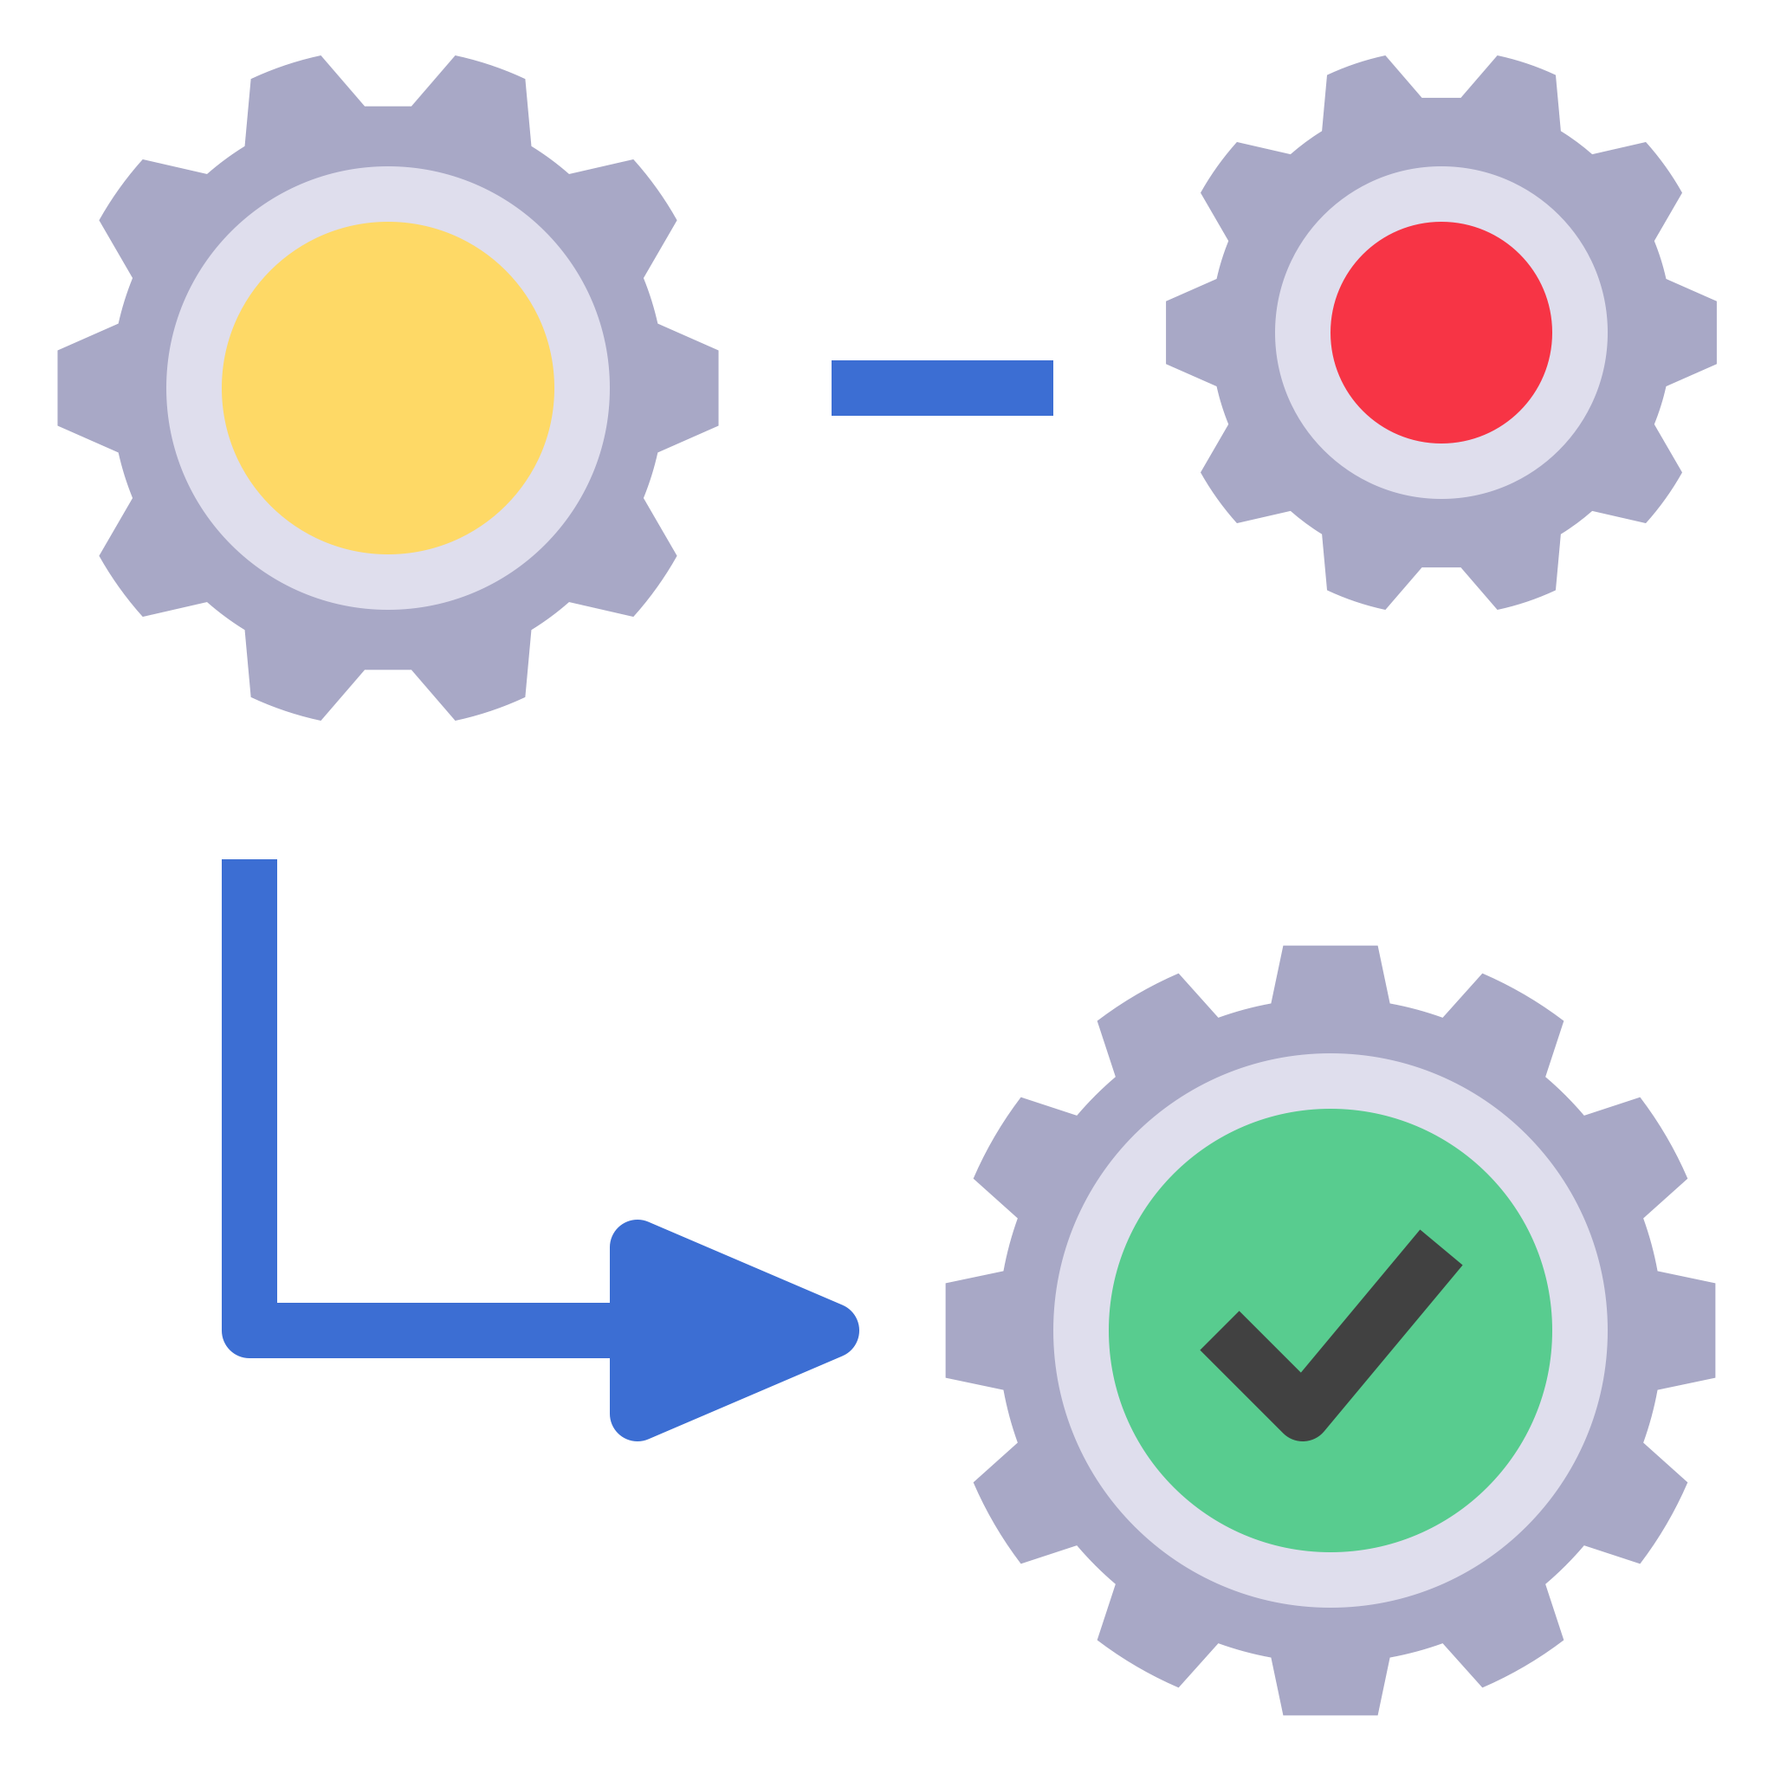


Java – Microservices infrastructure
Useful tools – Orchestration / Choreography
Service orchestration
orchestrator
Service orchestration represents a single centralized executable business process (the orchestrator) that coordinates the interaction among different services. The orchestrator is responsible for invoking and combining the services.
Disadvantages of Orchestration
Invocations time – The orchestrator needs to directly communicate with each service and wait for each service’s response.
Tight coupling – Services are highly dependent upon each other.
Reliance on RESTful APIs - typically created as tightly coupled services — so using them can actually increase the tight coupling in your architecture.

Slide 47
Java – Microservices infrastructure
Useful tools – Orchestration / Choreography
Service Choreography
Service choreography is a global description of the participating services, which is defined by exchange of messages, rules of interaction and agreements between two or more endpoints. Choreography employs a decentralized approach for service composition.
Event Broker
Disadvantages of Choreography
Hard to get right – it’s not easy to mange tons of services with differents development teams.
Complexity – the analysis of problems that can occurs can take much more time then orchestration.
At the end
For real-life use cases services need to collaborate. You need both: A choreographed event-based style as well as an orchestrated command-based style depending on the situation at hand. With a clever mix you reach the level of de-coupling you aim for especially when using microservices.

Slide 48
Thanks

